Slide 1
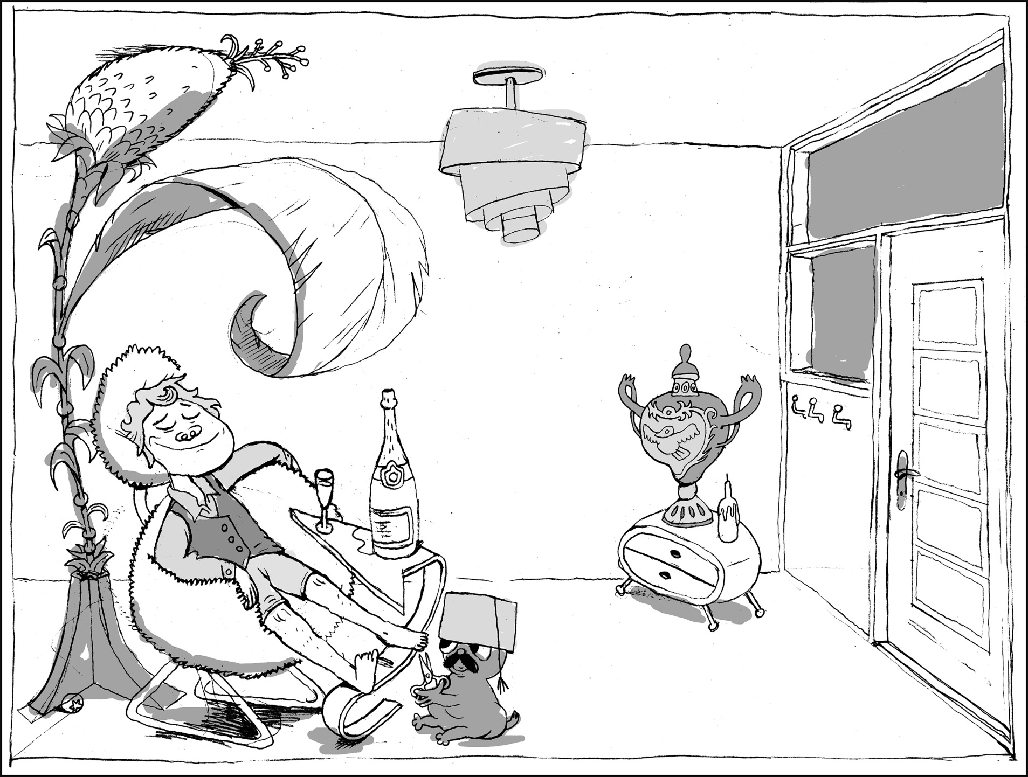
BALDER &
BALTHAZAR

Slide 2
CUT A BIT MORE ACROSS, WILL YOU DEAR? WE WOULDN’T WANT ANY INGROWN TOENAILS,
NOW WOULD WE?
OH CHEER UP BOY, WHEN YOU’RE DONE WITH THIS WE’LL GO BUY YOU THAT LUXURY LIVER PATÉ YOU LOVE.

Slide 3
I JUST FEEL SO RADIANT AND GENEROUS TODAY, DON’T KNOW WHY. MUST BE THE VASE.
I JUST GOT IT. WHAT DO YOU THINK? DOESN’T IT SUIT ME? I FEEL LIKE THAT’S WHAT I’D LOOK LIKE IF I WAS A VASE.

Slide 4
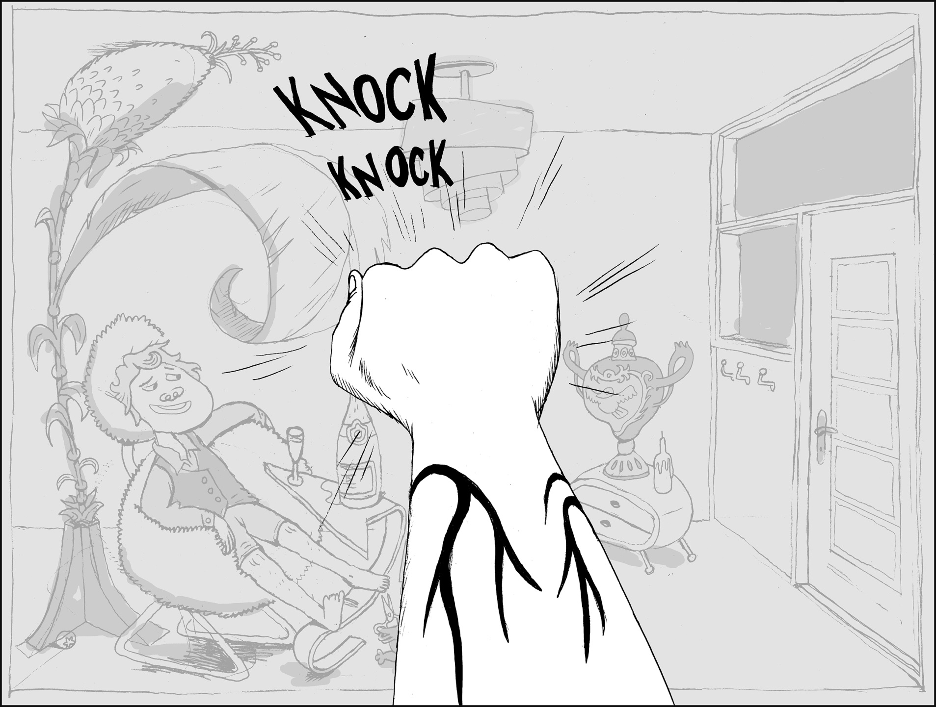

Slide 5
COME IN, COME IN! THERE’S NO LOCKS IN THIS ESTABLISHMENT!

Slide 6
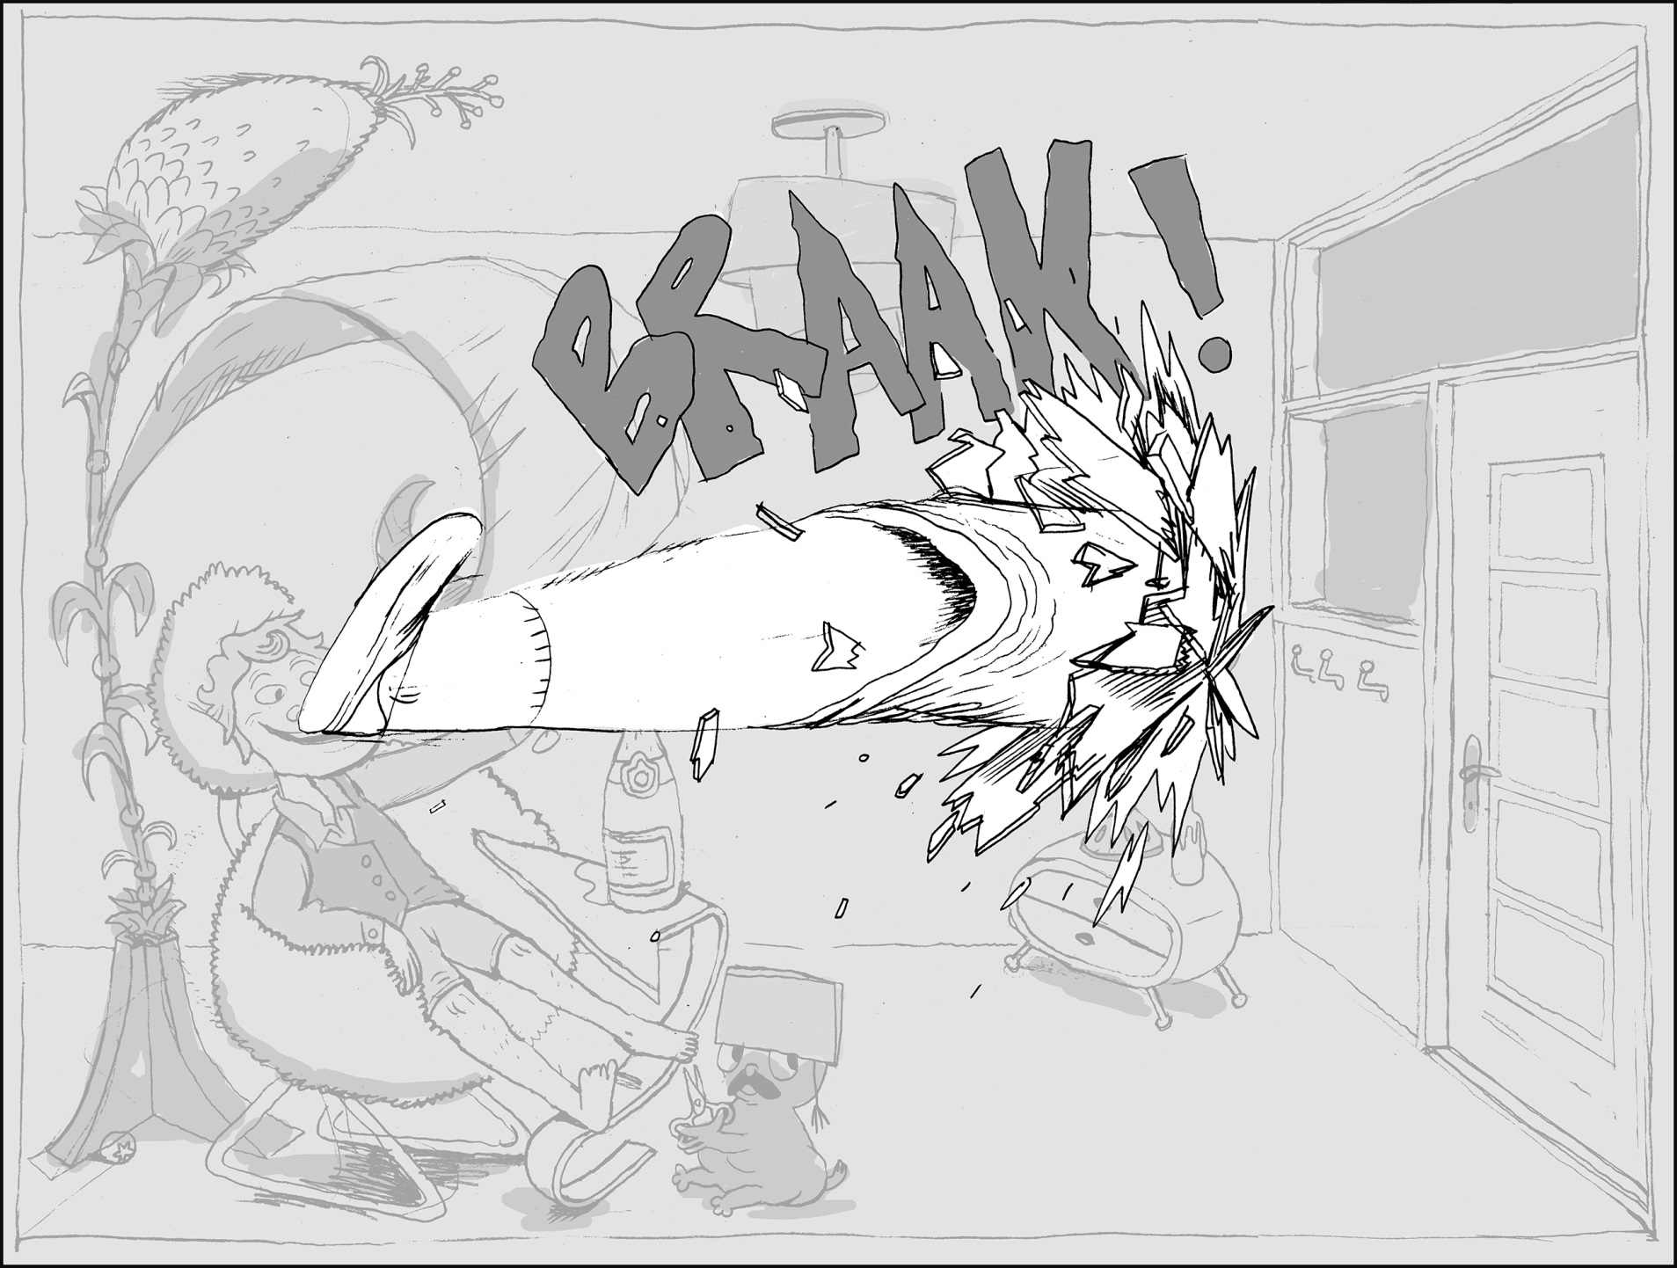

Slide 7
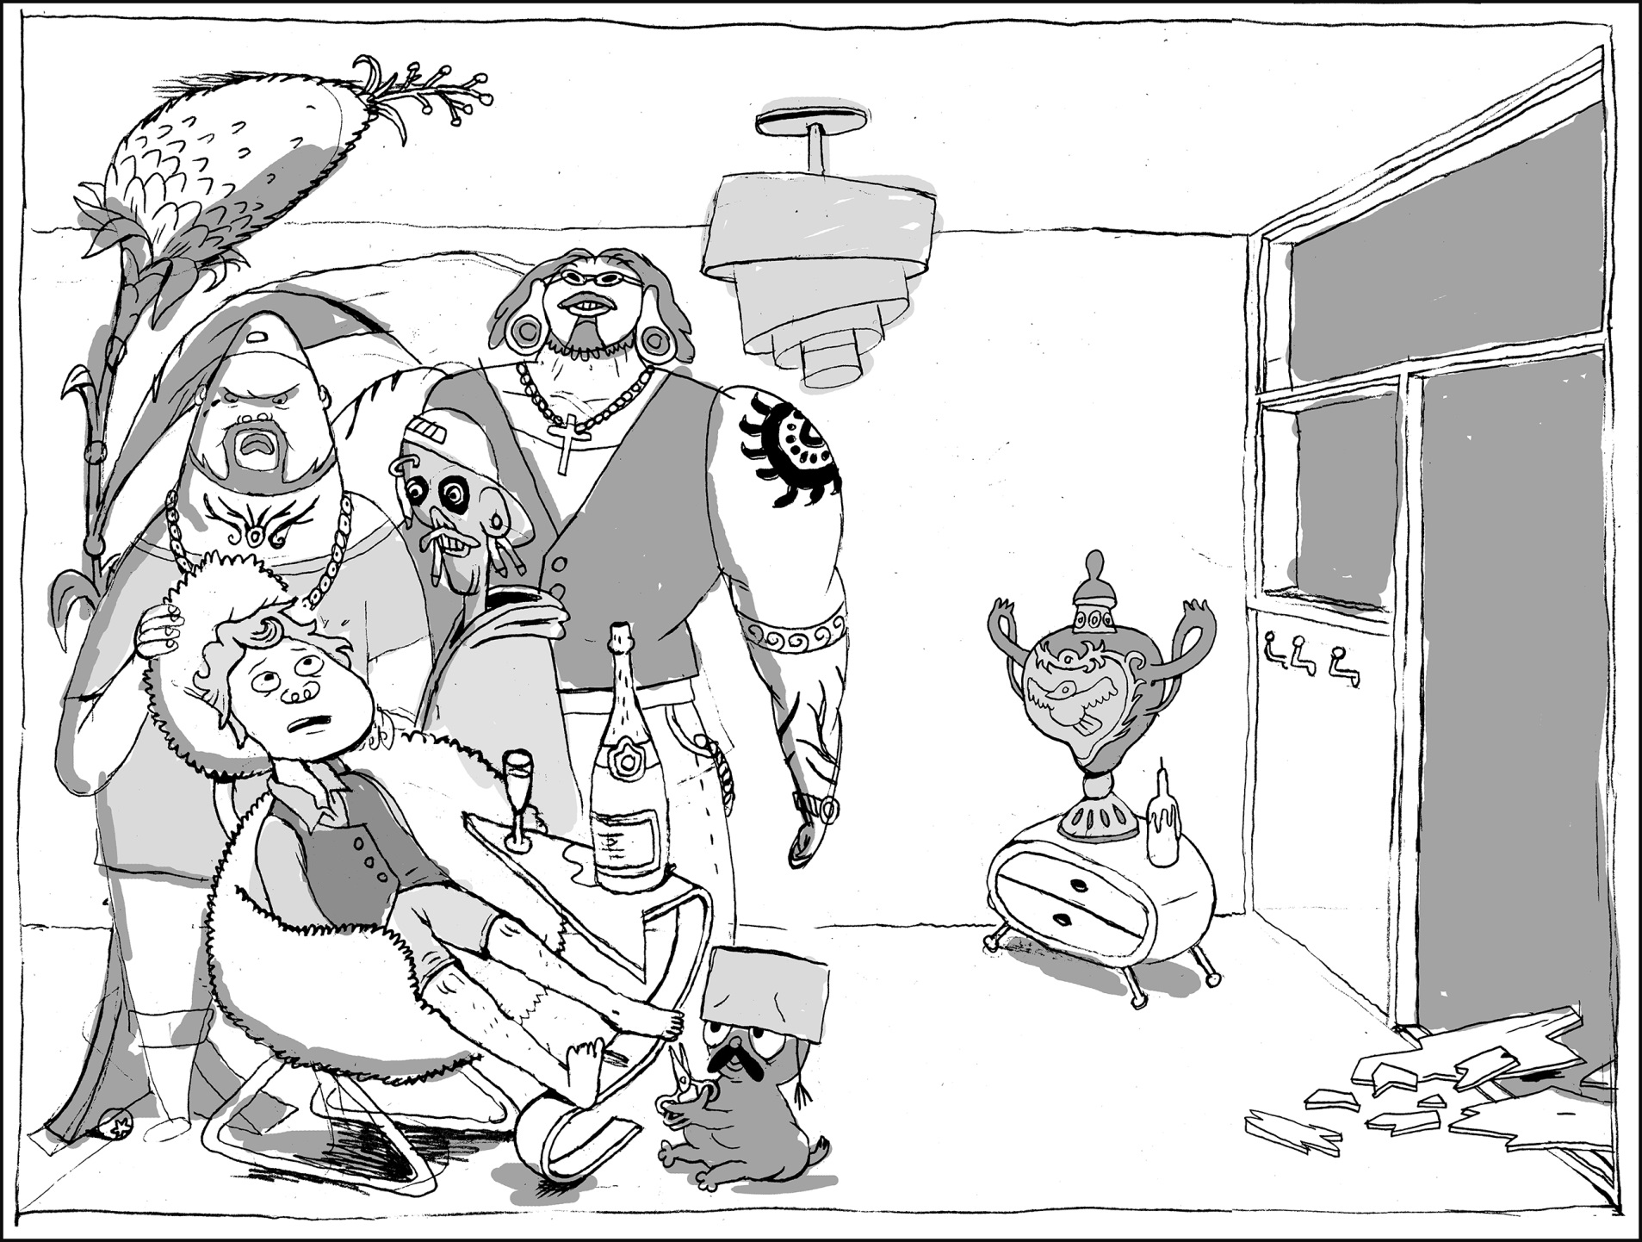

Slide 8
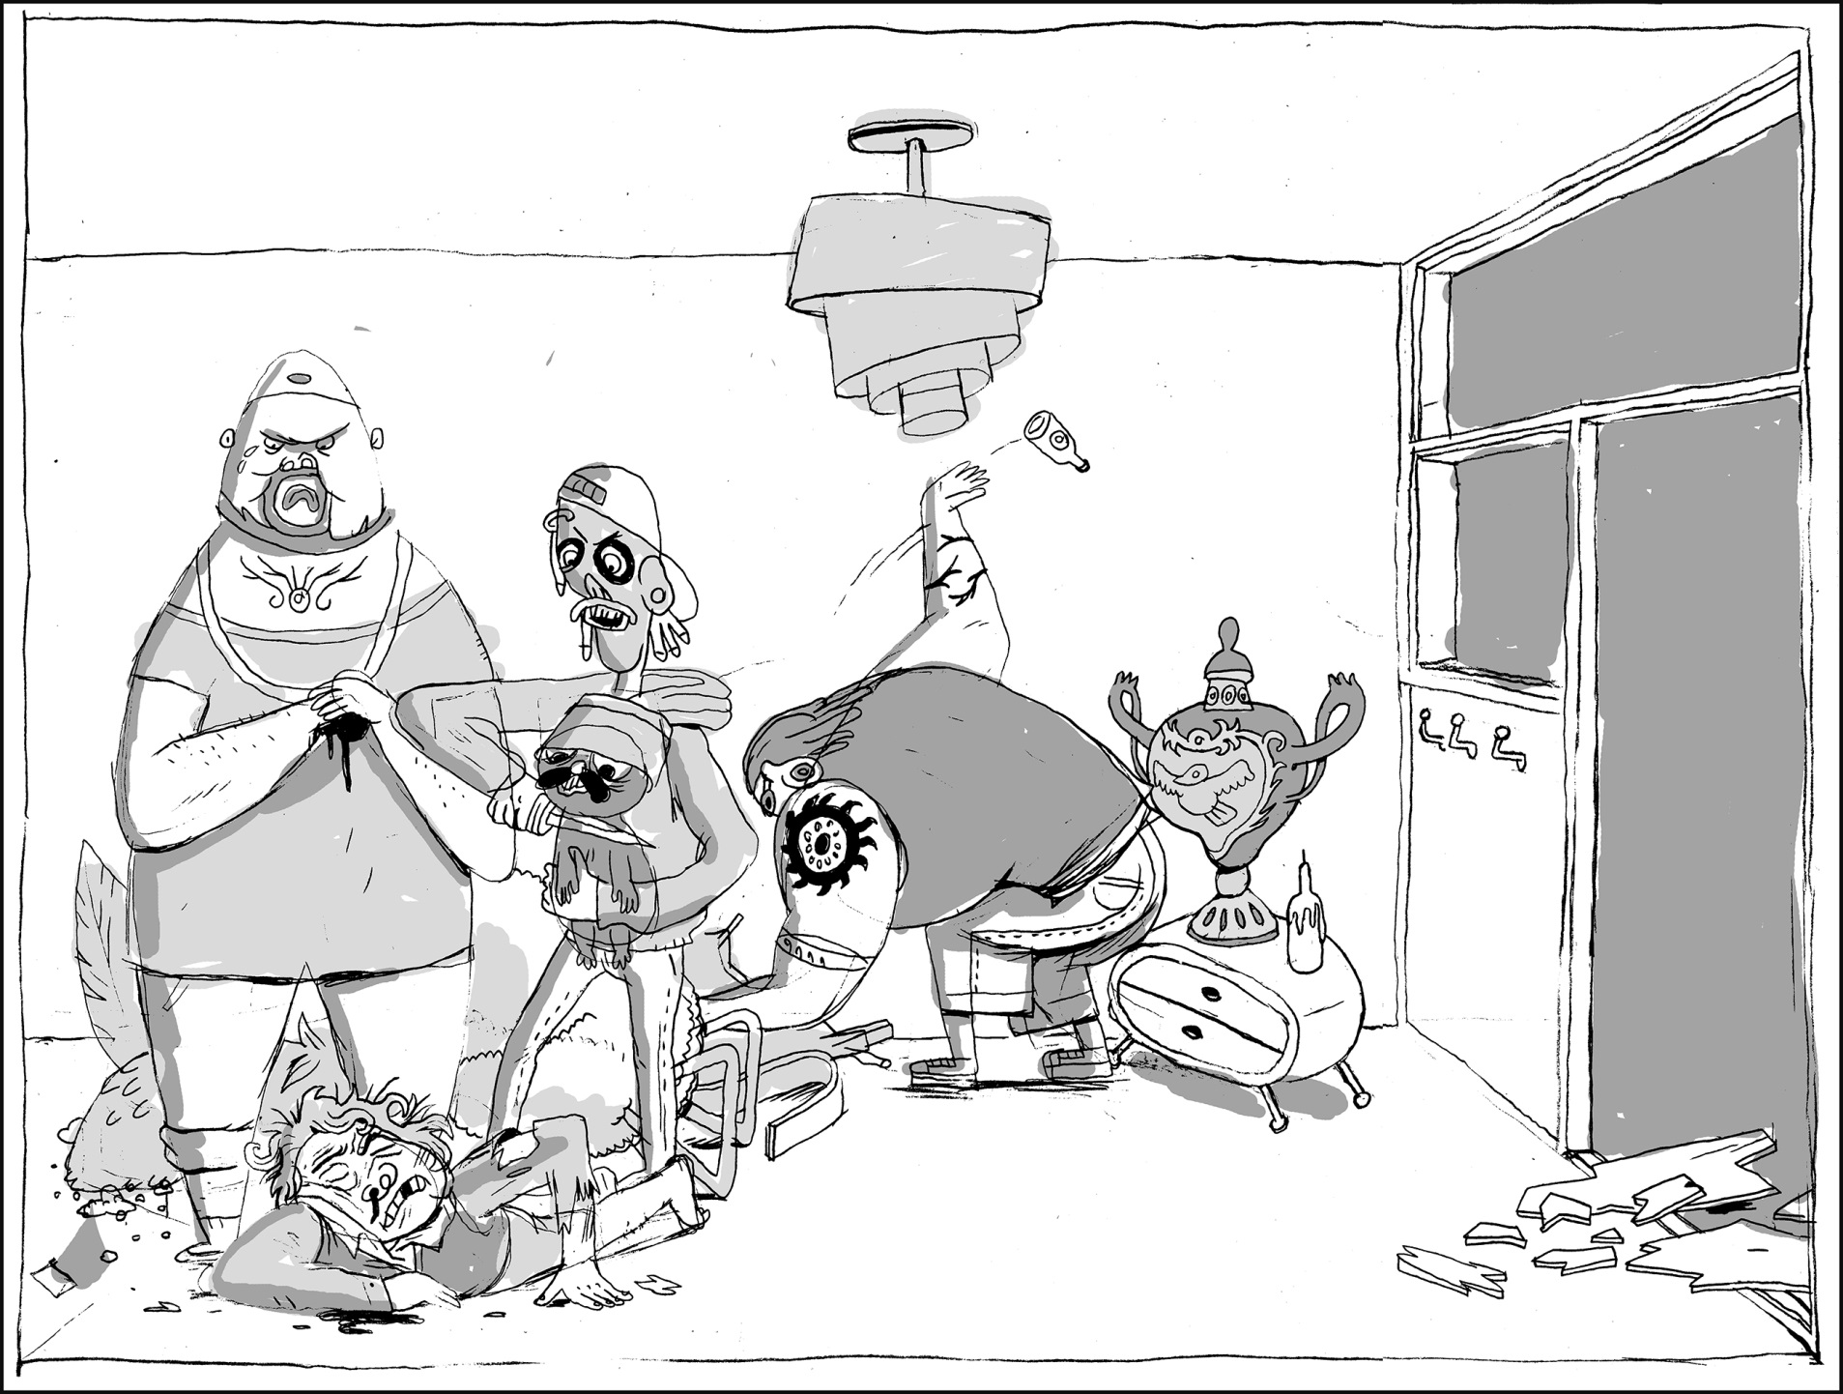
SO WHEREYA HIDING IT, DUDE?
I – I GOT NO CLUE WHAT THIS IS ABOUT.

Slide 9
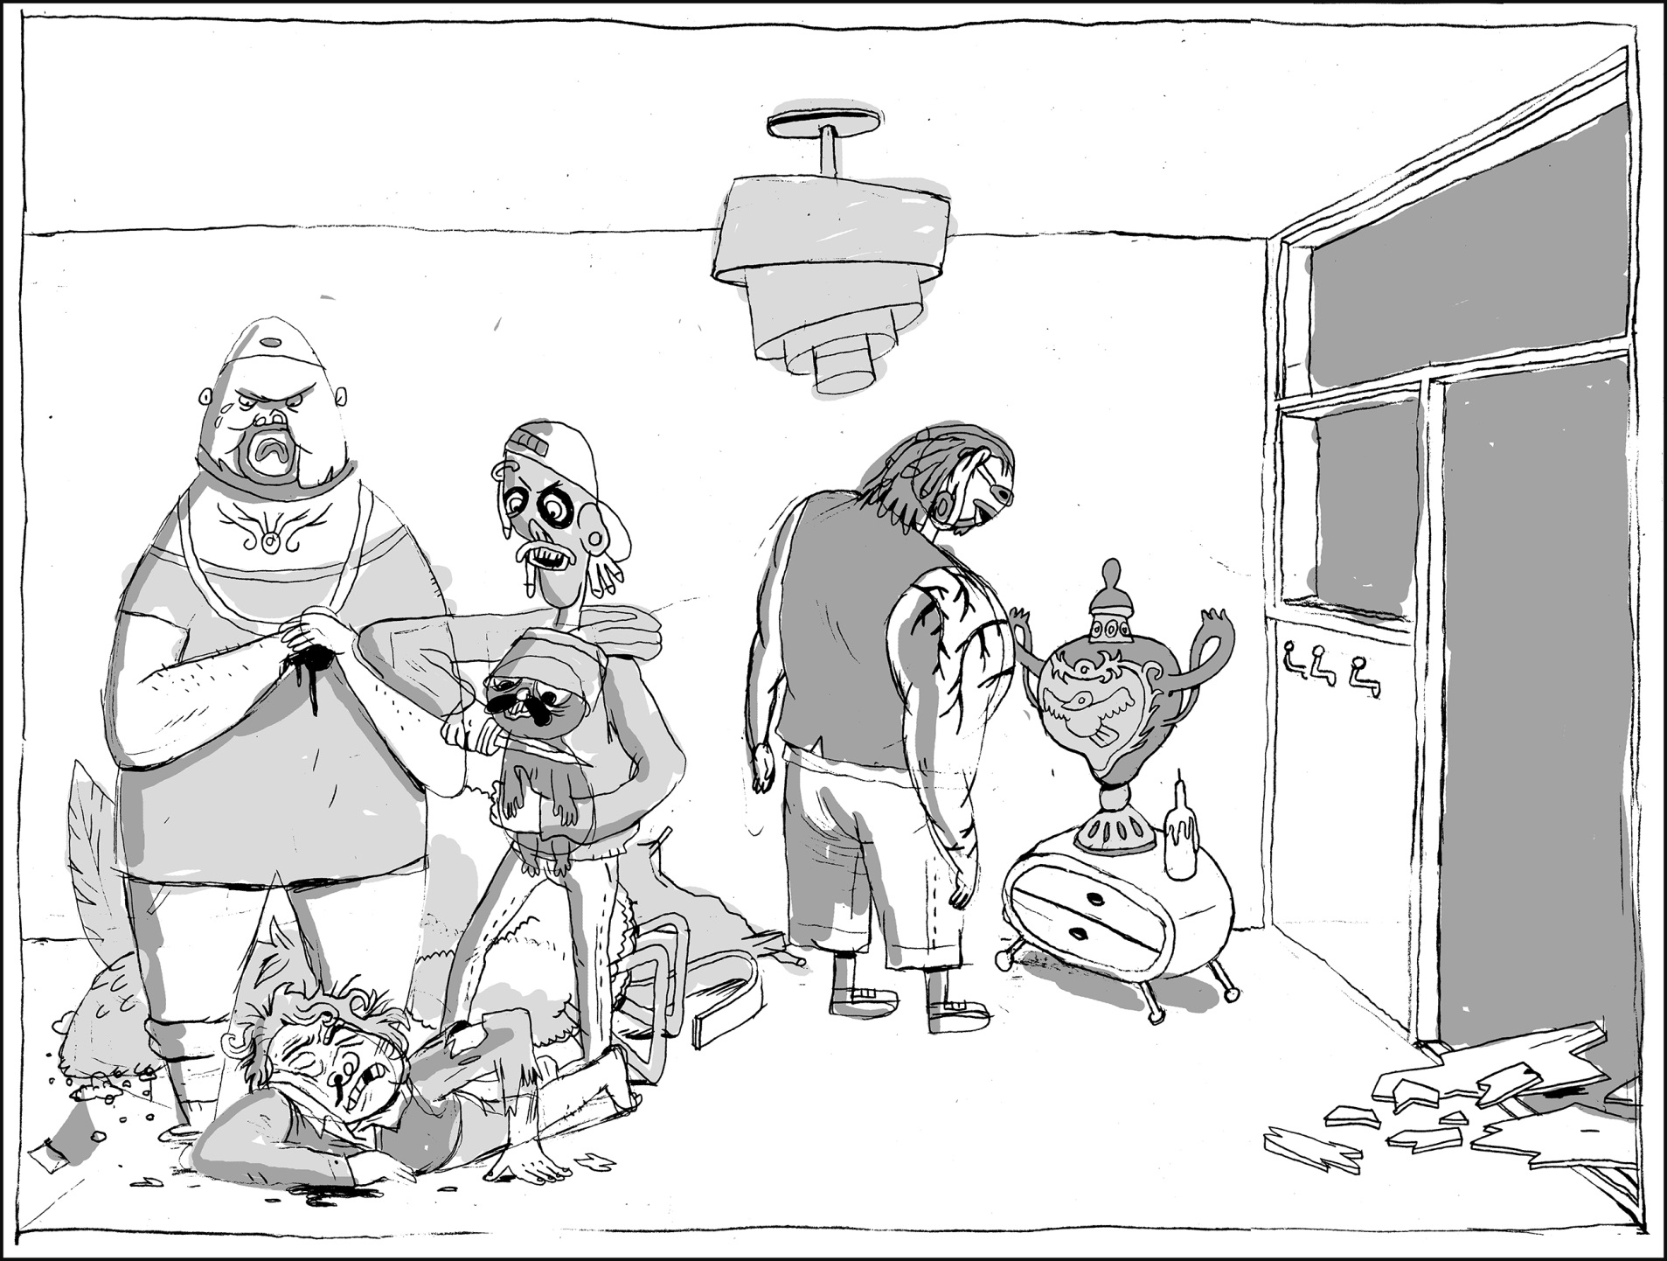
CUT THE BULLSHIT, MAN. OR I’LL CUT IT FOR YOU!

Slide 10
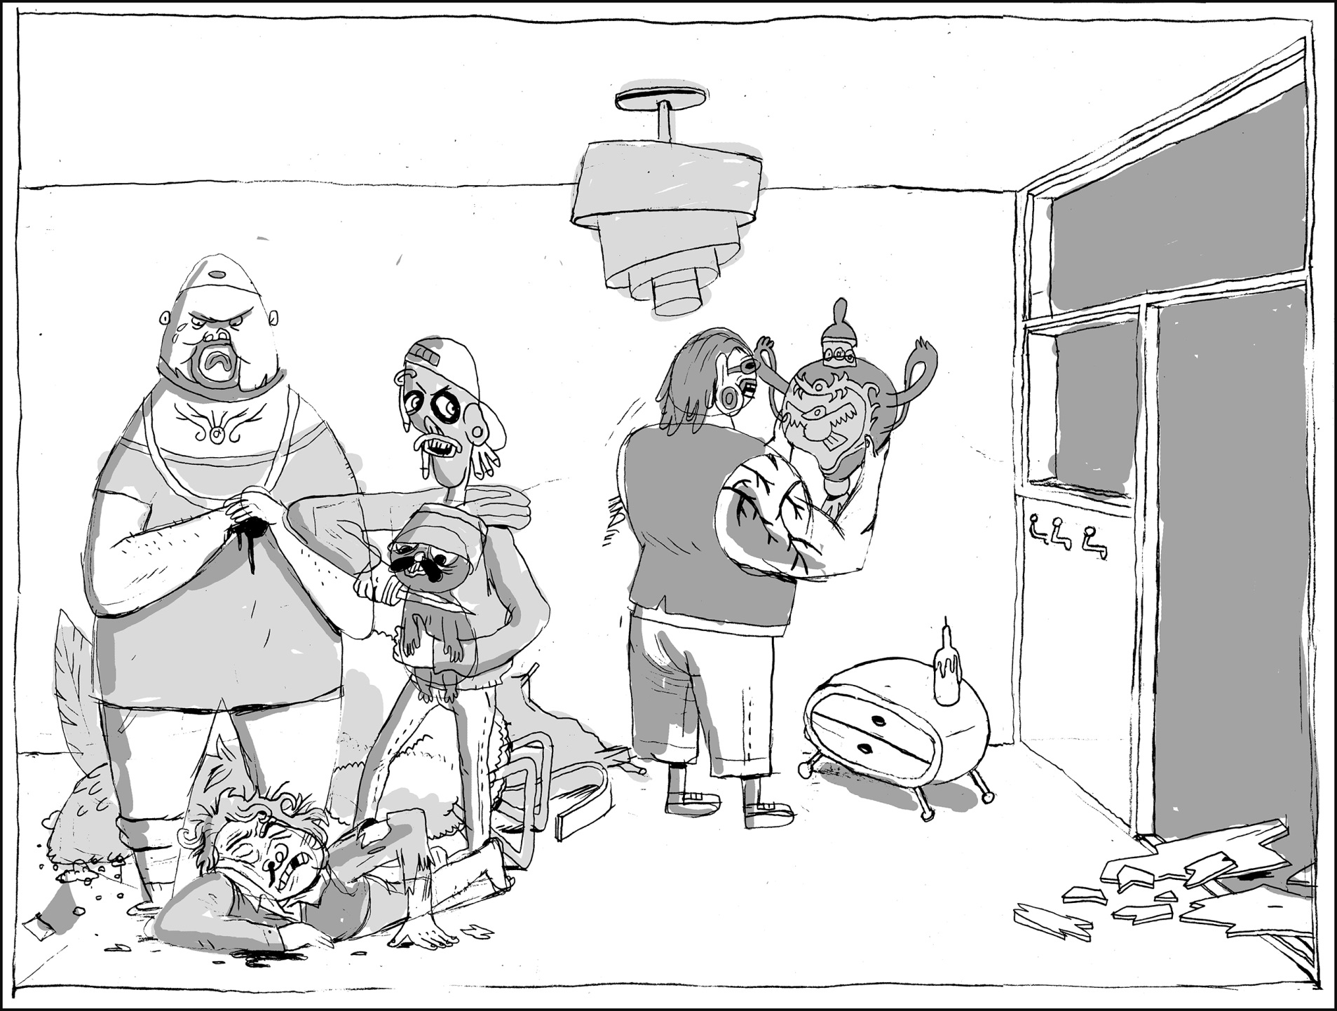
I FOUND IT! YAY!

Slide 11
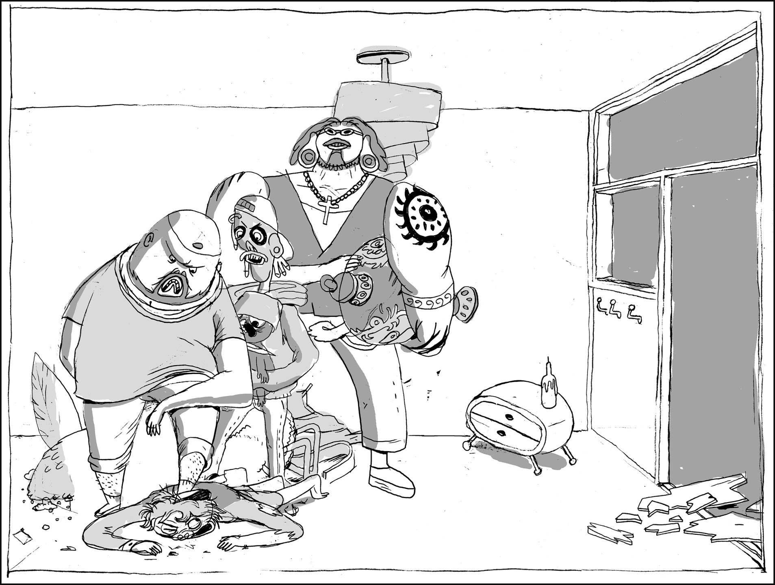
OH, THE V-VASE. THAT CAN ACTUALLY EASILY BE EXPLAINED.
NO NEED. WE UNDERSTAND.

Slide 12
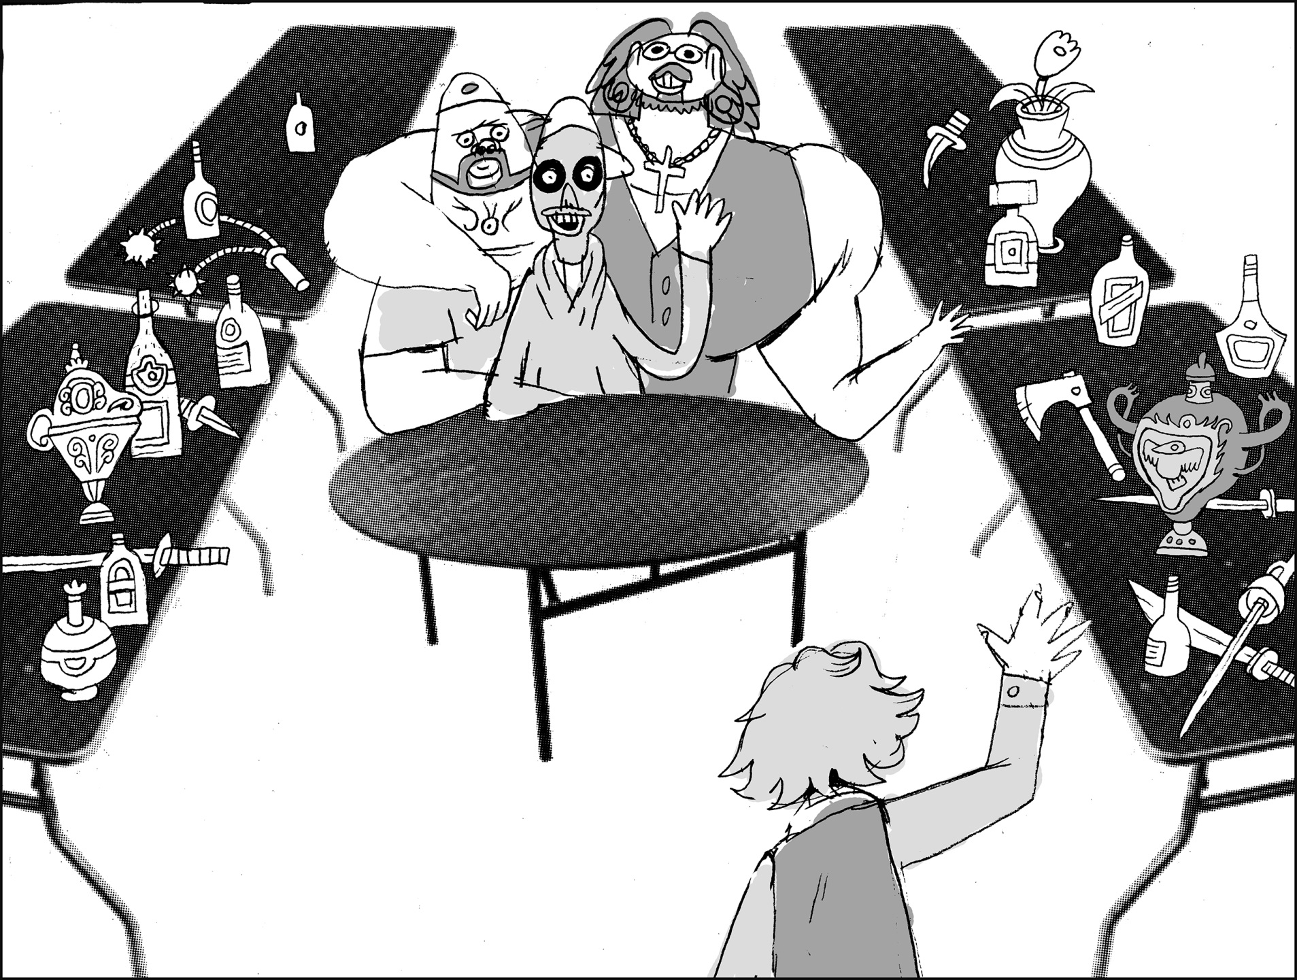
IT WAS YOUR FIRST TIME SHOPPING AT THE BLACK MARKED YESTERDAY, NO? I BET YOU FELT REAL COOL, NO?

Slide 13
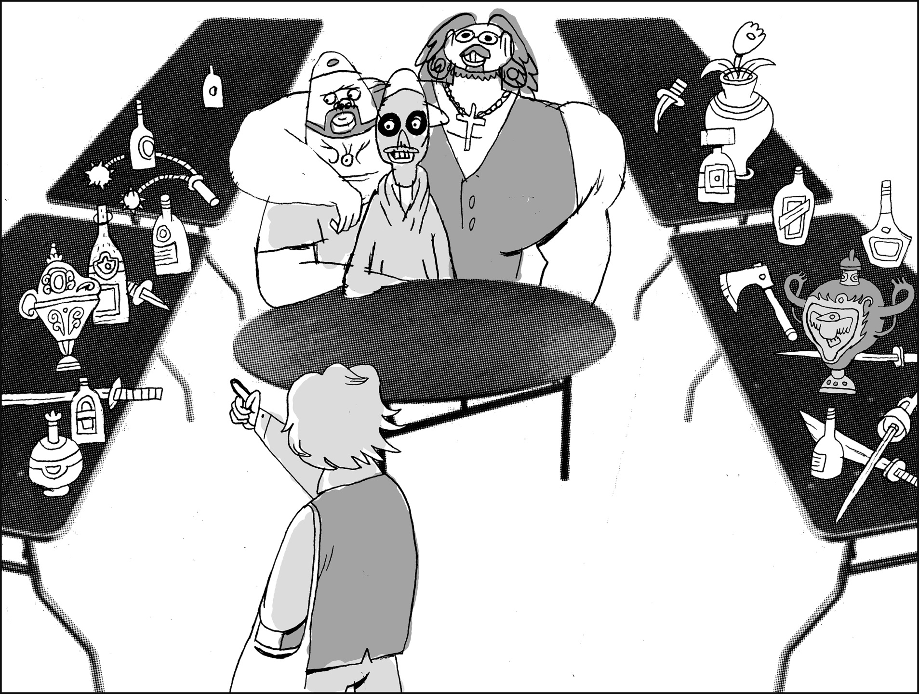
”I’M A CRIMINAL TOO. I’M NOT AFRAID OF ANYTHING.”

Slide 14
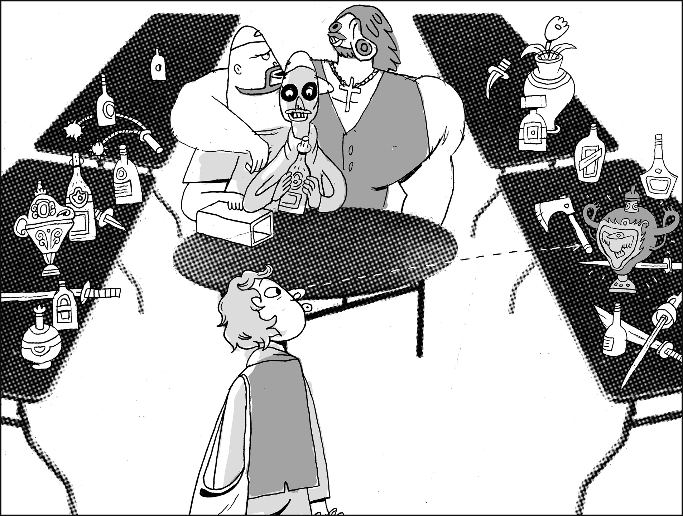
THEN YOU SAW THE VASE,

Slide 15
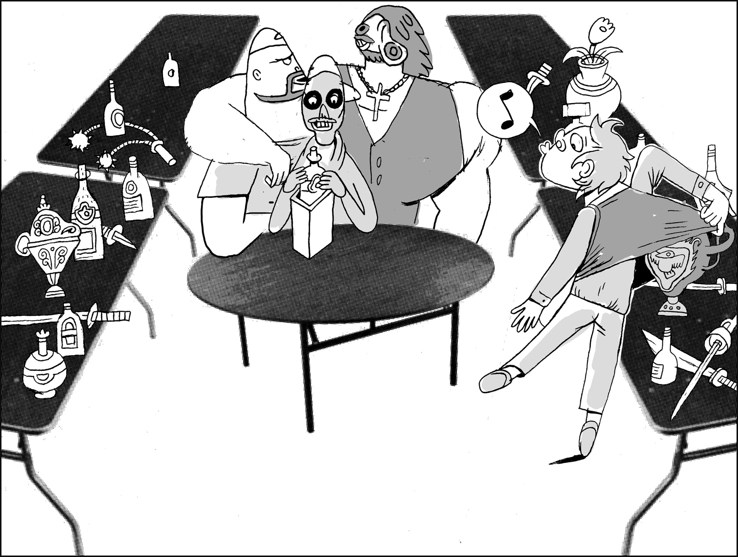
AND THE REST IS HISTORY.

Slide 16
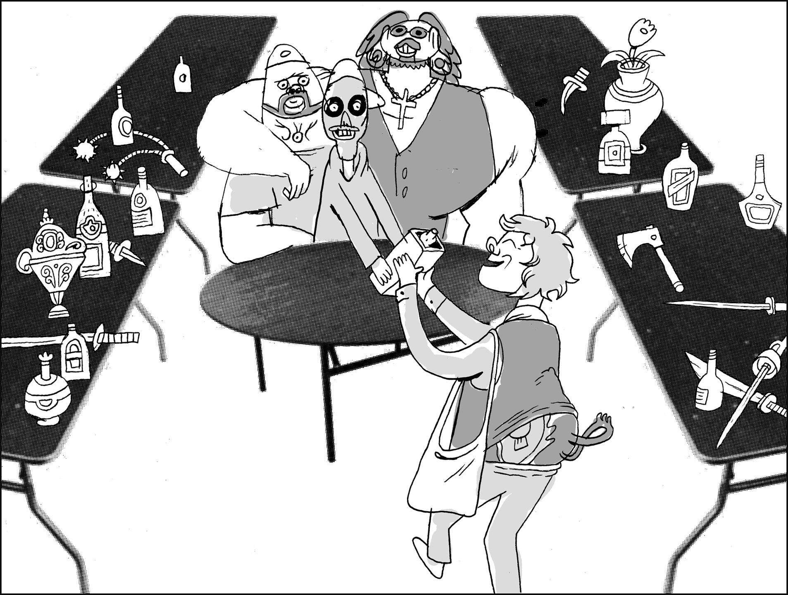

Slide 17
WELL, THAT WASN’T JUST ANY VASE. IT’S A LATE JAQUE CHASSIGNELLES, DUDE!
I TOTALLY UNDERSTAND YOUR PERSPECTIVE HERE. IF I WAS IN YOUR SHOES, I WOULD UNDOUBTEDLY LAND AT THE SAME CONCLUSION.
BUT ALLOW ME TO EXPLAIN…

Slide 18
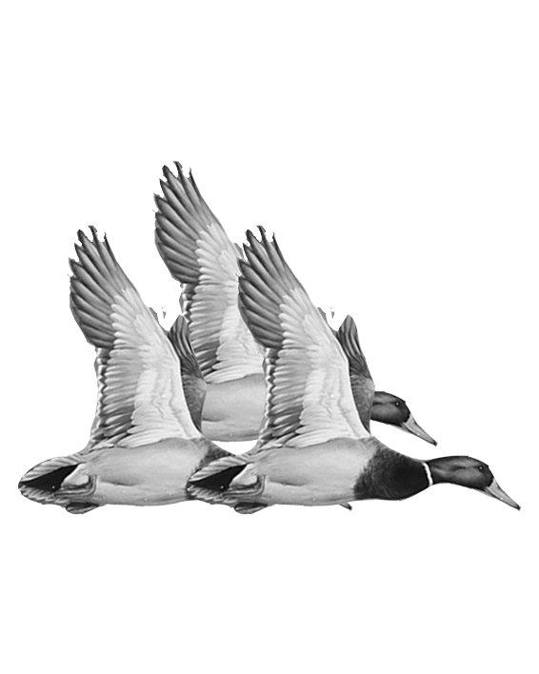
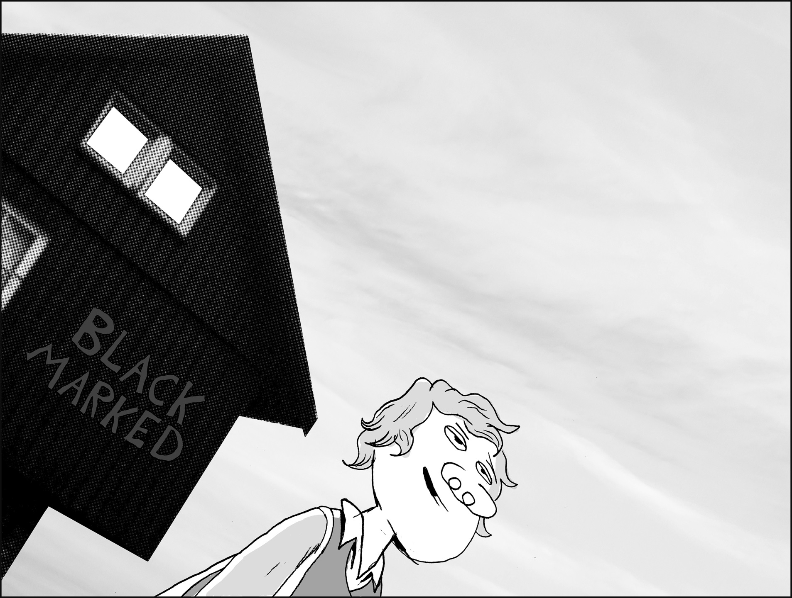
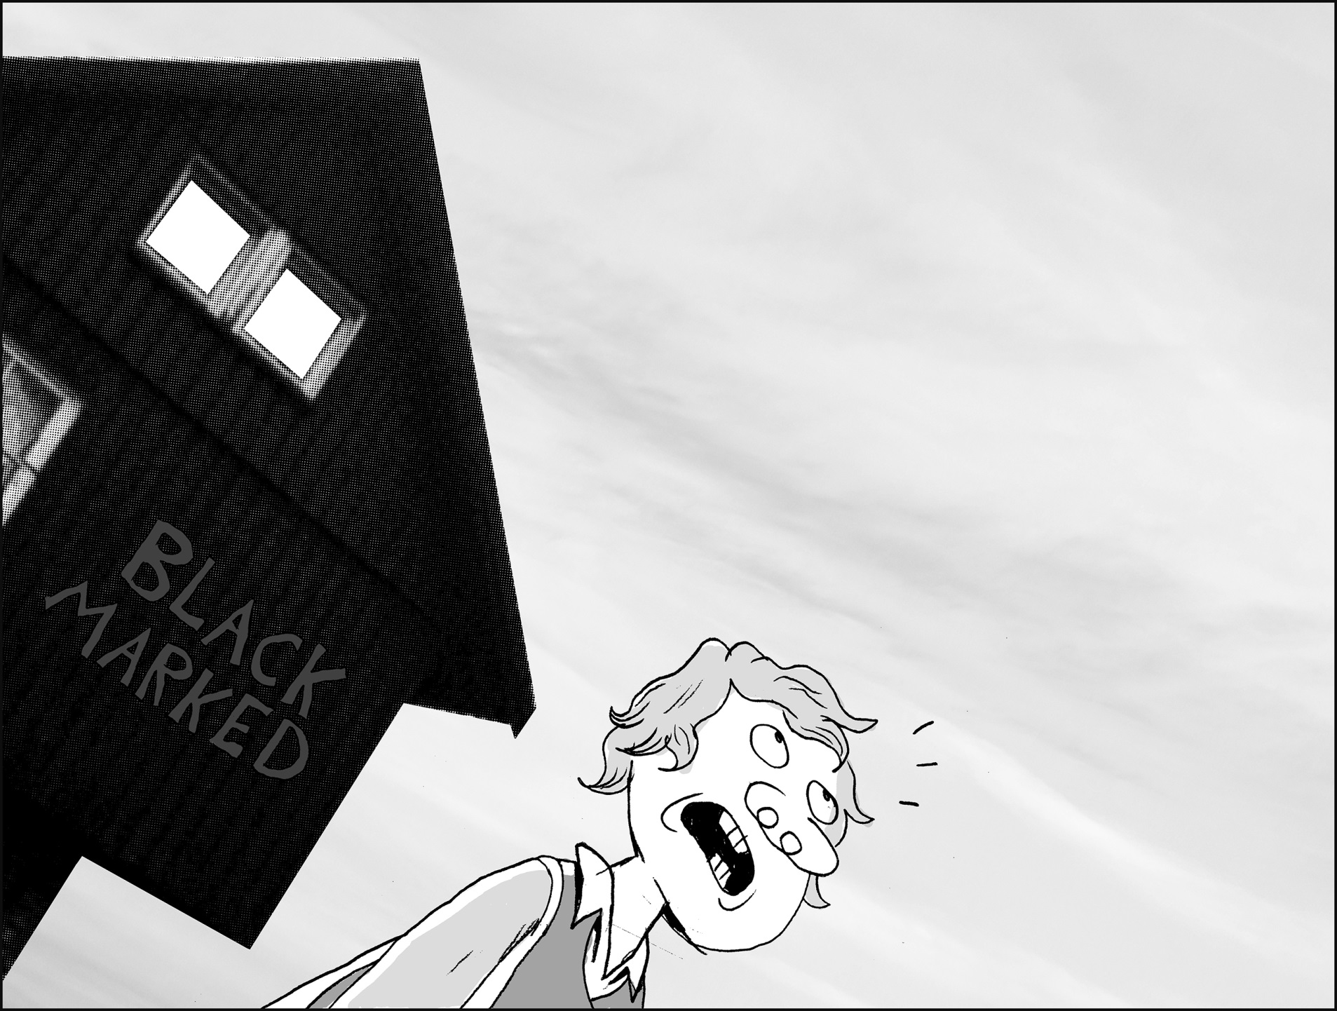
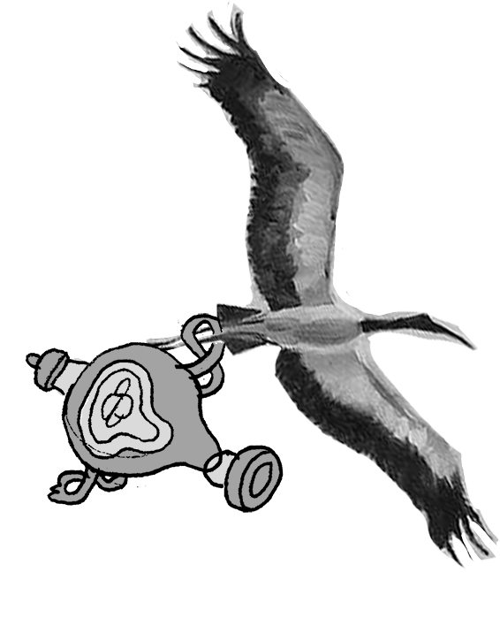
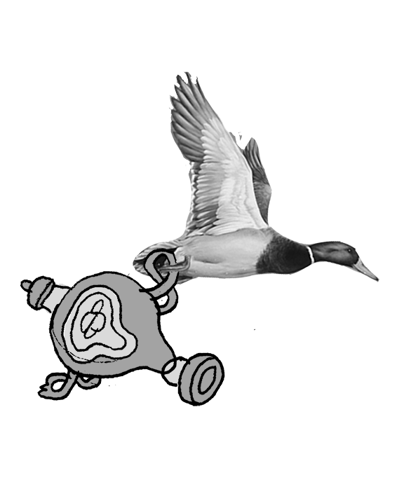
A CRANE? IN NOVEMBER?? AREN’T THEY MIGRATORY BIRDS?
A MALLARD? HOW THE HECK DID IT MANAGE TO CARRY THAT VASE???
WHAT KIND OF BIRD
WAS IT?
I WAS JUST LEAVING YOUR FINE ESTABLISHMENT WHEN… EH…
…A BIRD FLEW AWAY
WITH THE VASE!
UH… A CRANE, I THINK.
MALLARD. IT WAS A MALLARD, I REMEMBER NOW.
IT… HAD HELP. FROM IT’S MALLARD FRIENDS.

Slide 19
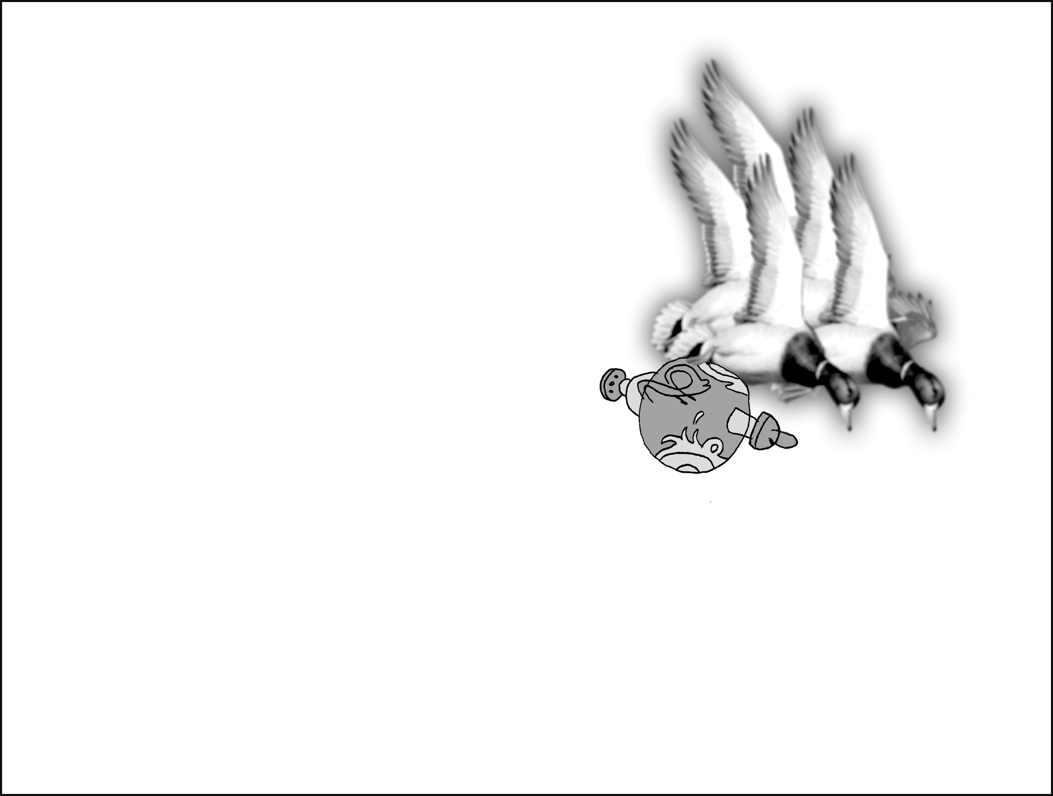
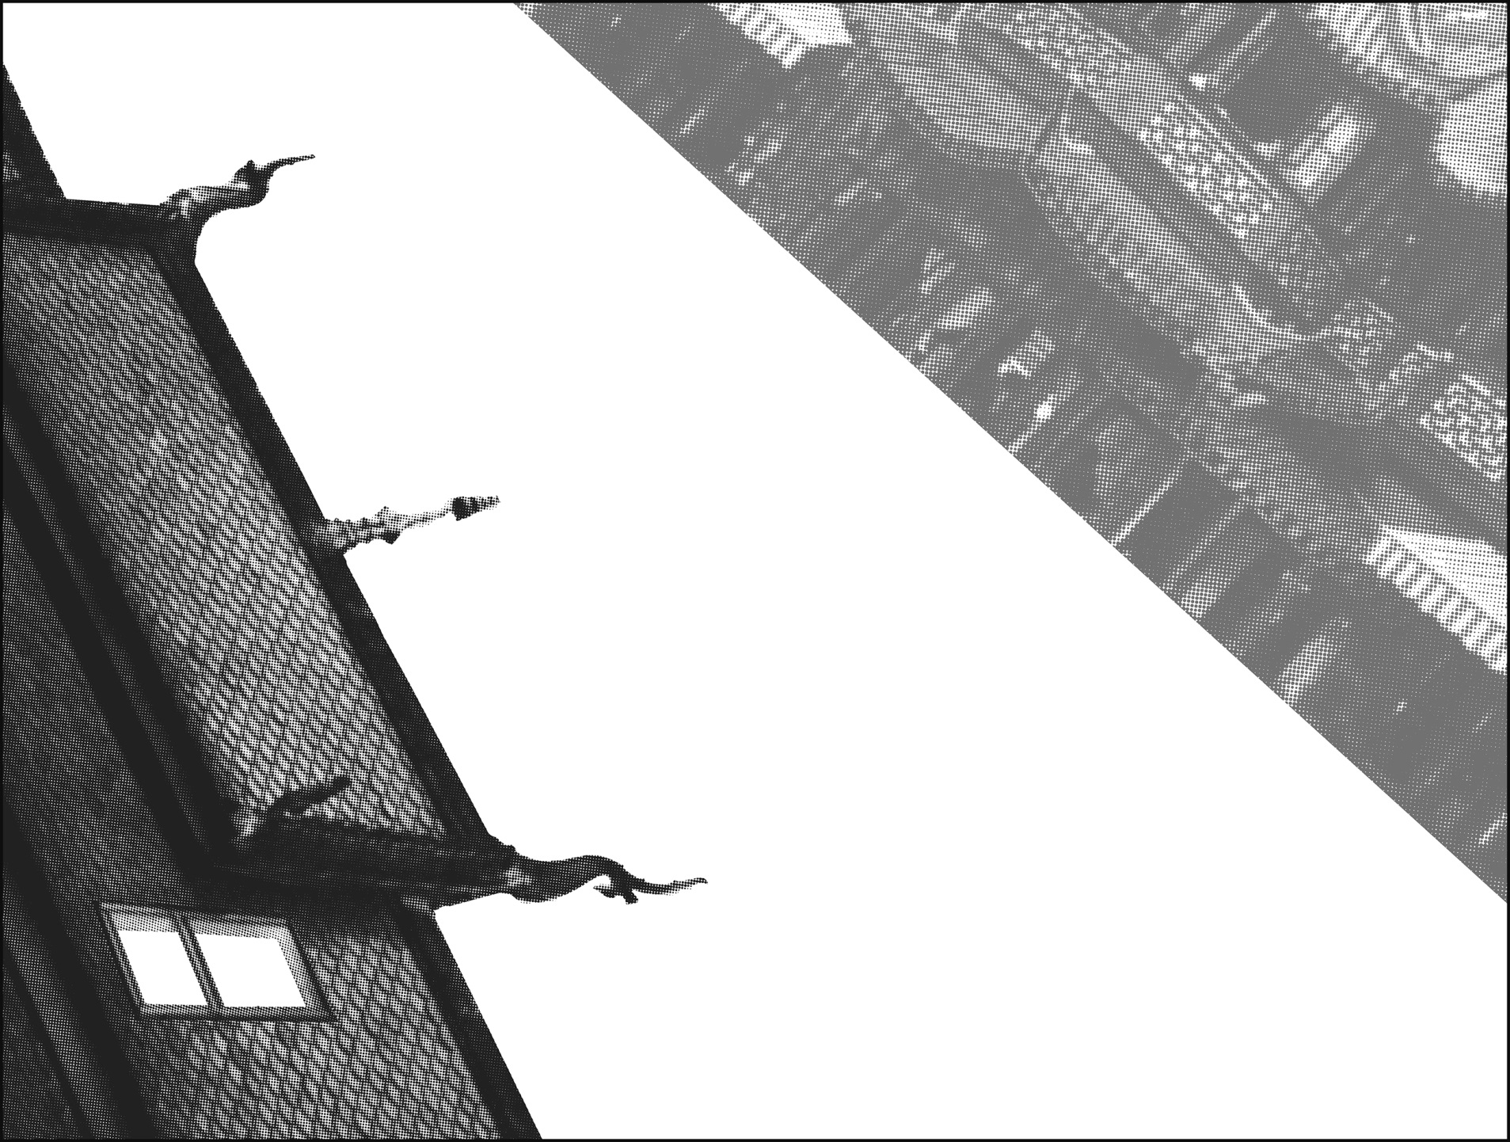
ANYWAY, SO… KNOWING THE INVALUABLE VALUE OF THIS ARTIFACT, I NATURALLY CHASED THEM. ALL THE WAY DOWN OSCAR STREET.
DID I SAY OSCAR STREET? I MEANT CHINATOWN. I ALWAYS GET THOSE TWO CONFUSED.
ISN’T OSCAR STREET CLOSED FOR MAINTENANCE?

Slide 20
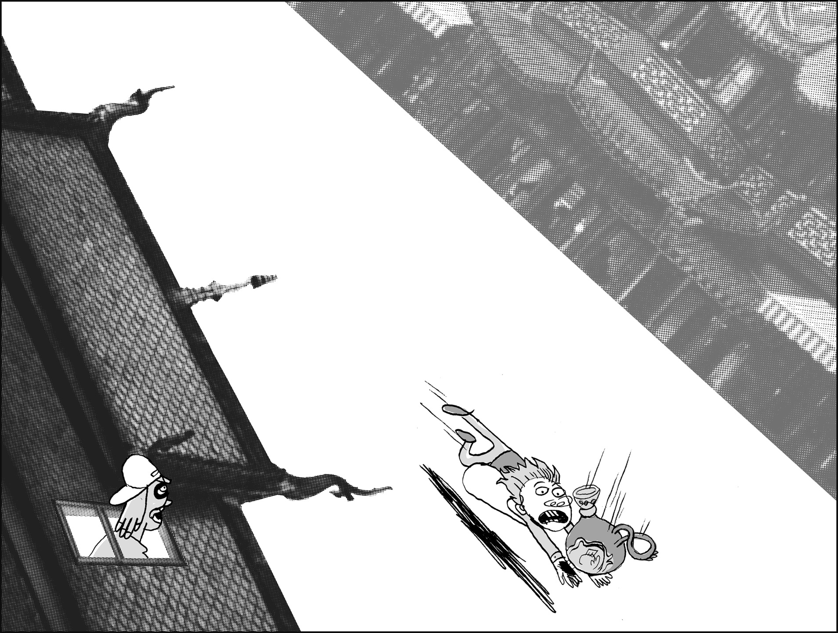
SO, EVENTUALLY THE MALLARDS GAVE UP AND DROPPED THE VASE. THANK GOD I WAS THERE!
SO WHY DIDN’T YOU RETURN IT, DUDE?

Slide 21
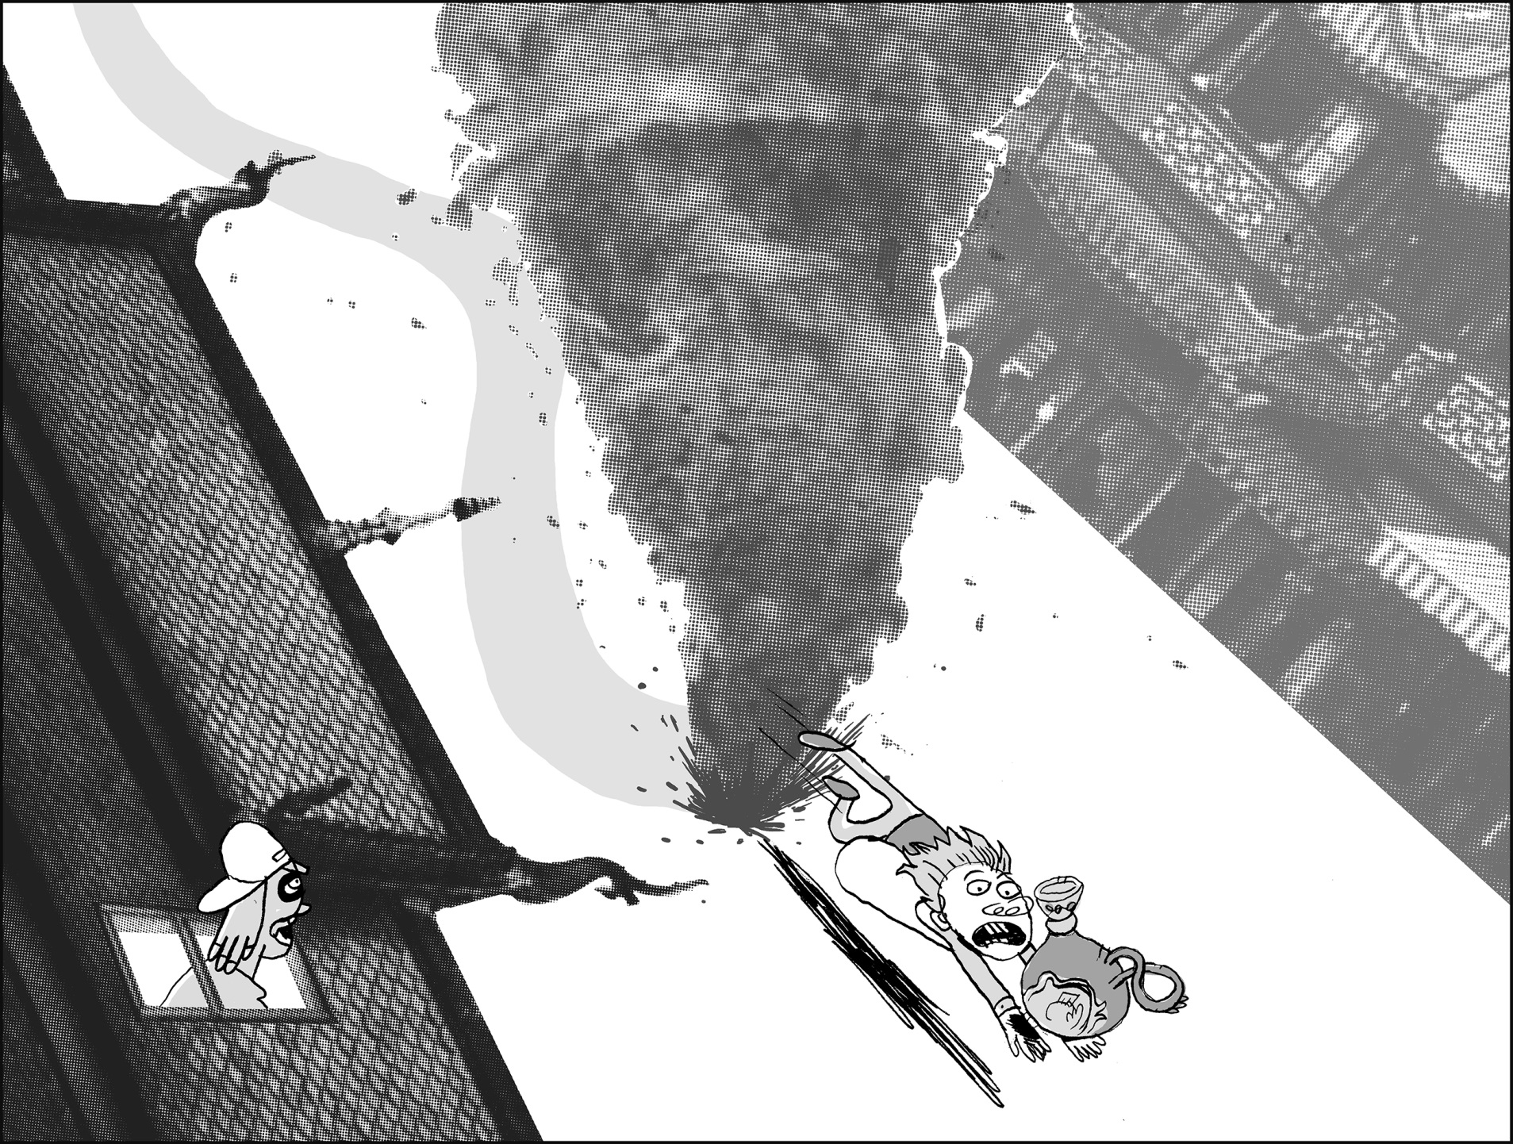
WELL, EH… BECAUSE OF
THE TORNADO.
A TORNADO? IN THE MIDDLE OF TOWN???

Slide 22
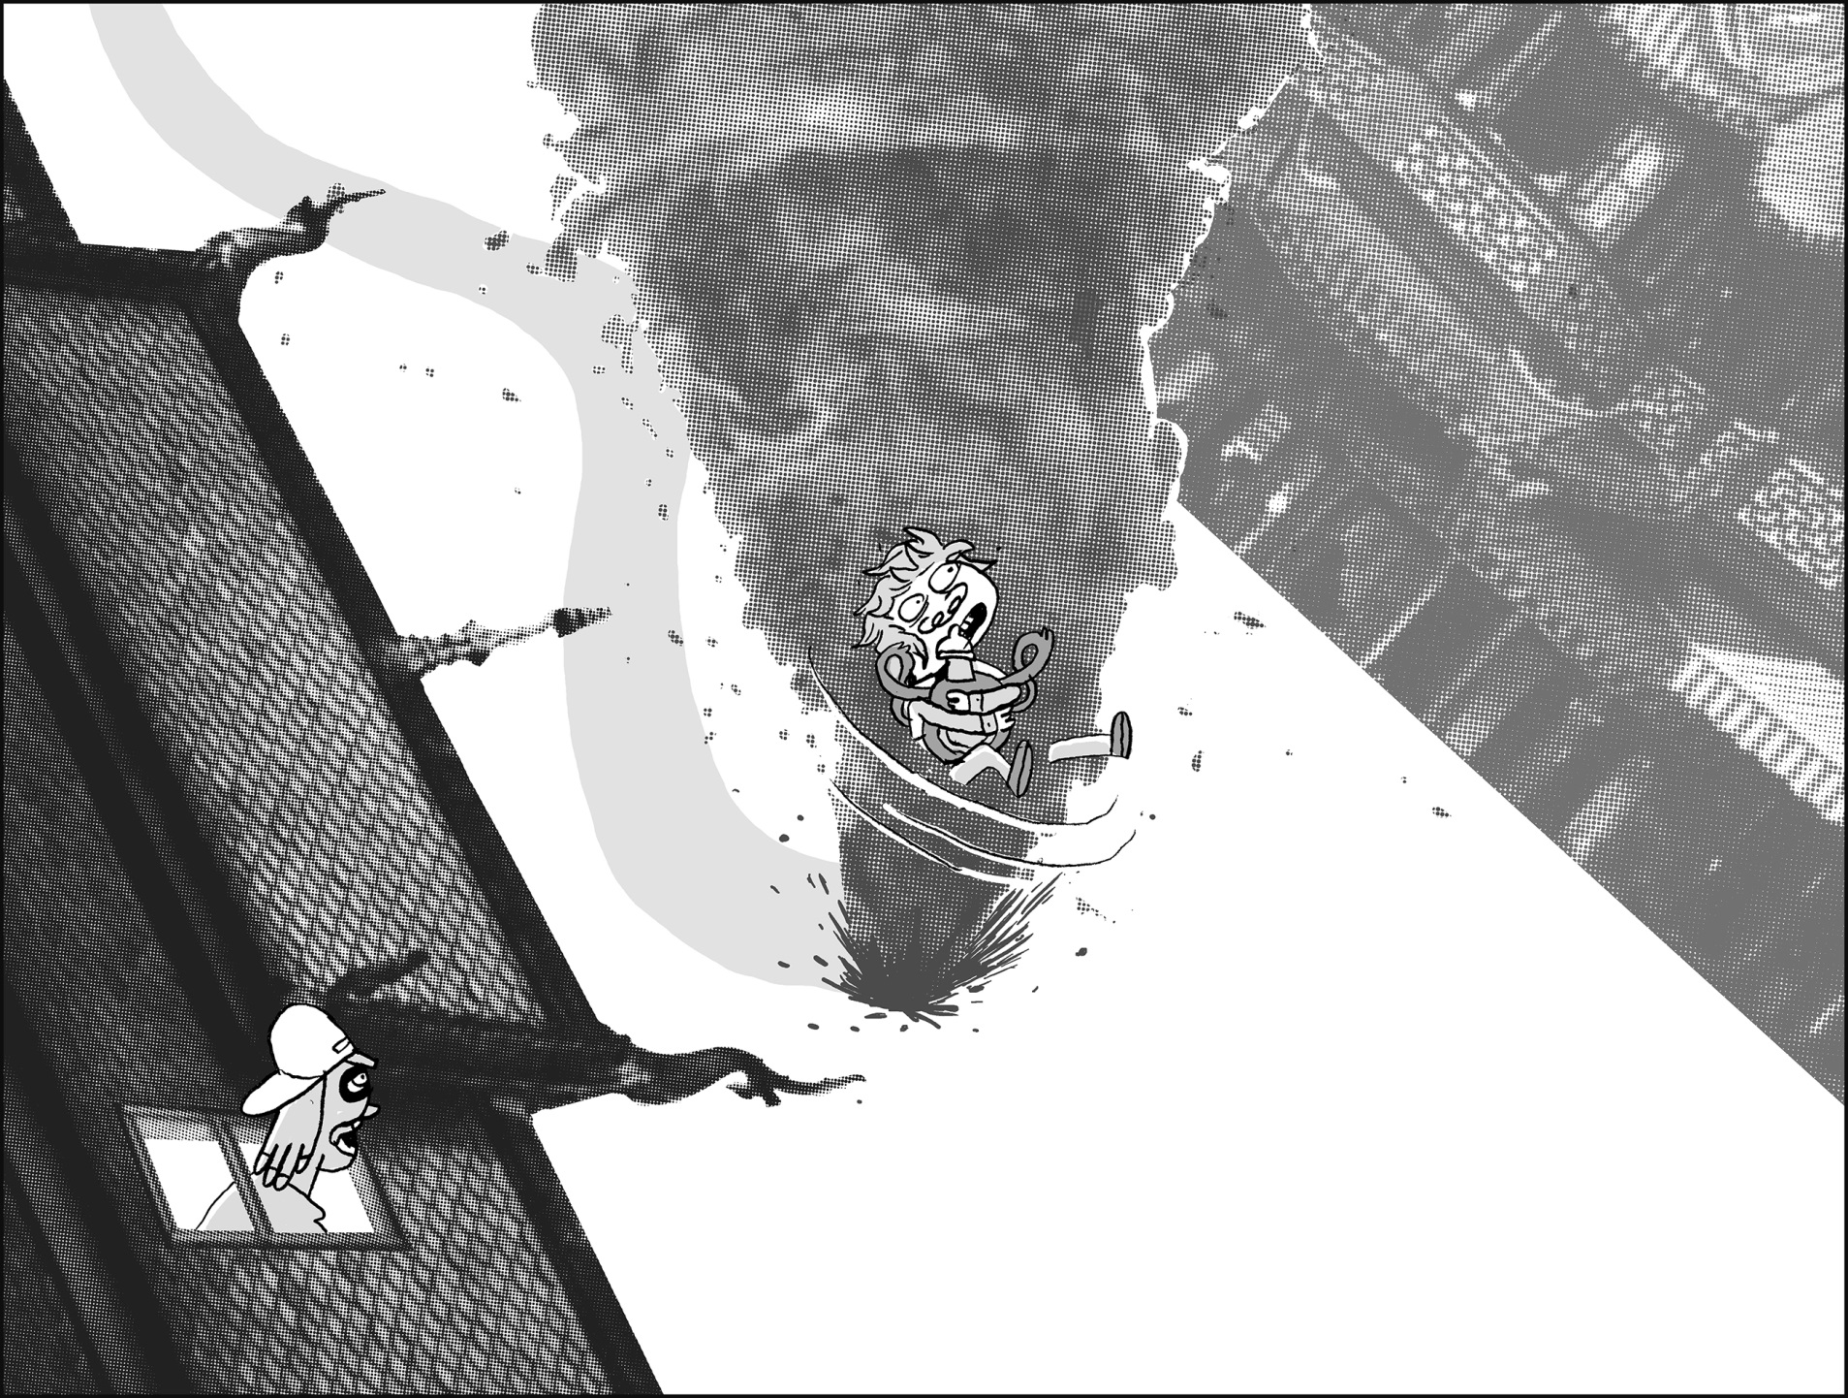
YEAH, I COULDN’T BELIEVE IT EITHER.
BUT… BUT… HOW COME THE CITY IS NOT IN TOTAL RUIN?

Slide 23
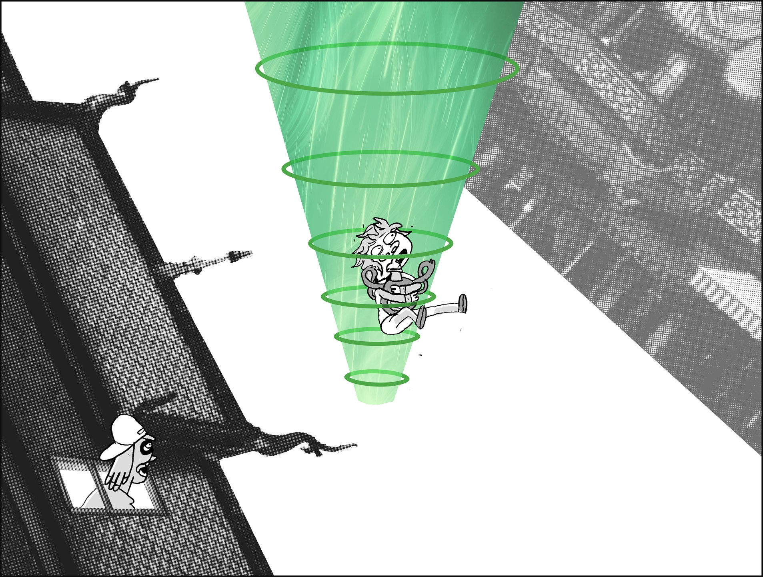
ACTUALLY IT WAS A UFO.
WHAT, REALLY??
YEP, I GOT ABDUCTED BY ALIENS.

Slide 24
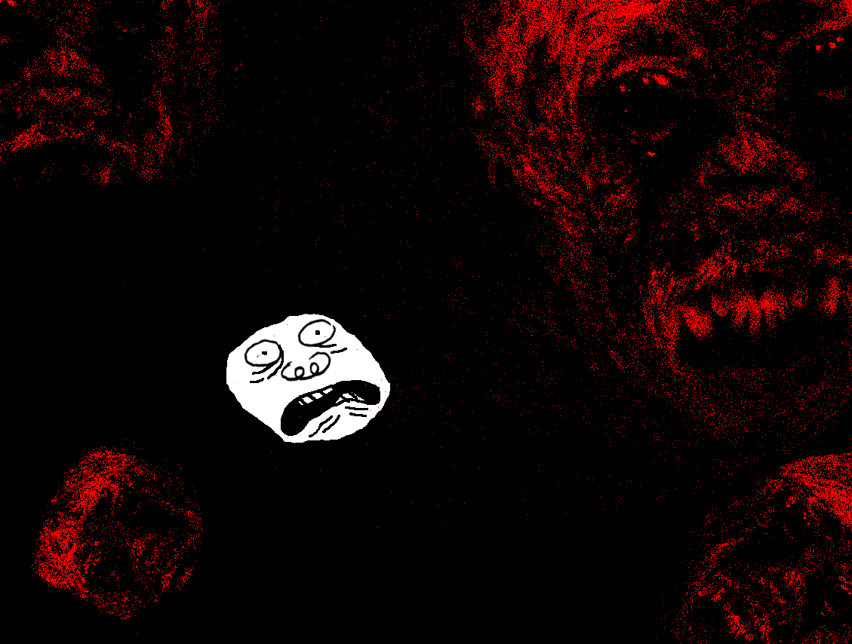
THEY DID UNSPEAKABLE THINGS TO ME, TRULY UNSPEAKABLE THINGS. PLEASE DON’T ASK ME ABOUT.

Slide 25
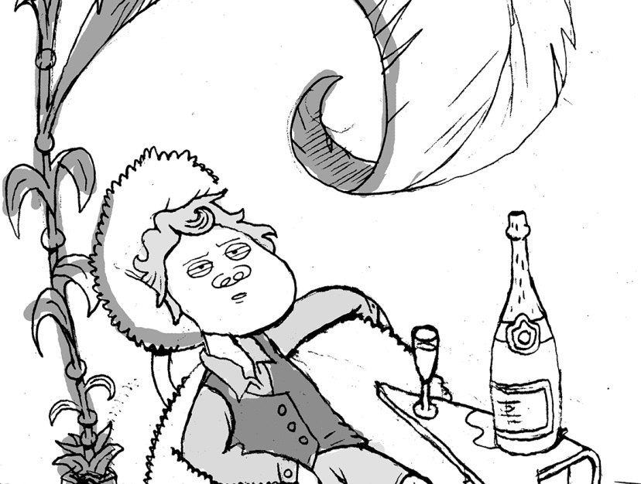
AND NEXT THING I KNOW, I JUST WAKE UP AT HOME LIKE NOTHING HAD HAPPENED.
NOT REMEMBERING
A THING OF WHAT JUST WENT DOWN.
I MEAN, IT’S ALL COMING
BACK NOW. BUT THAT’S WHY I DIDN’T GET IN CONTACT WITH YOU FINE GENTLEMEN BEFORE.

Slide 26
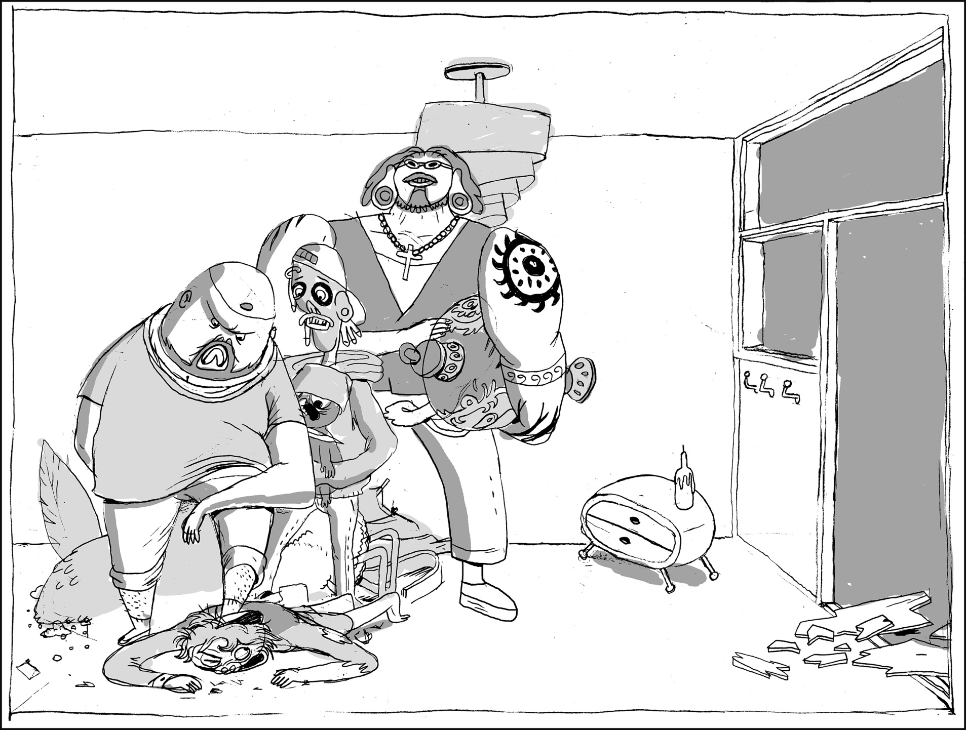
SO THERE YOU HAVE IT.

Slide 27
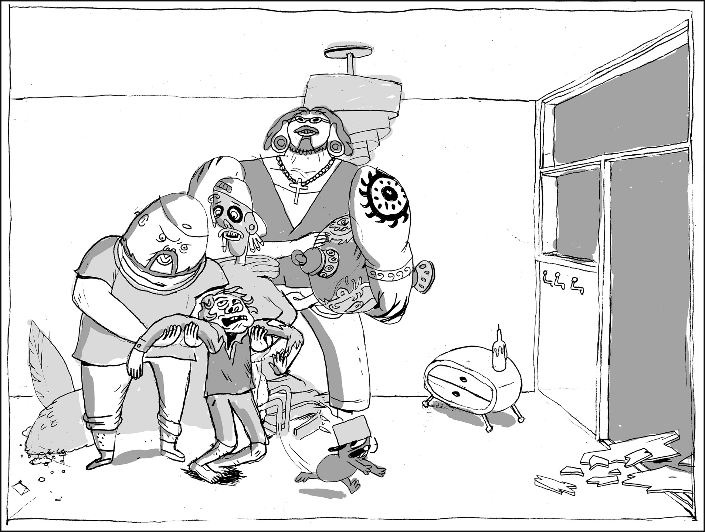
SHIT, WHAT CAN WE SAY? THANK YOU. AND SORRY FOR, YOU KNOW…
AH, DON’T WORRY ABOUT IT. IT’S AN HONEST MISUNDERSTANDING.

Slide 28
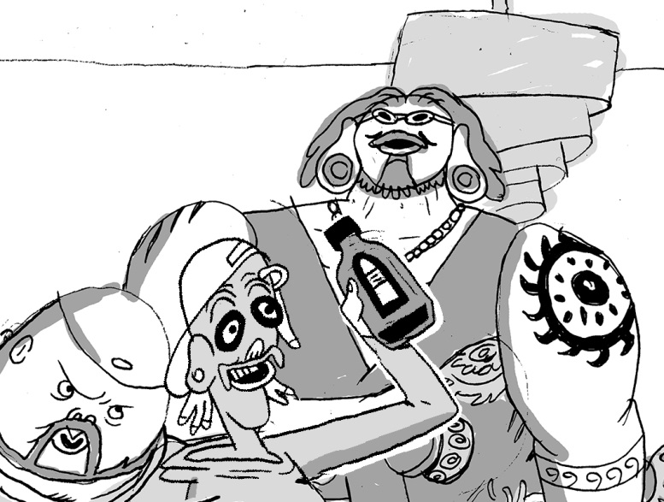
THE
END
YEAH MAN! LET’S DRINK TO THAT!

Slide 29
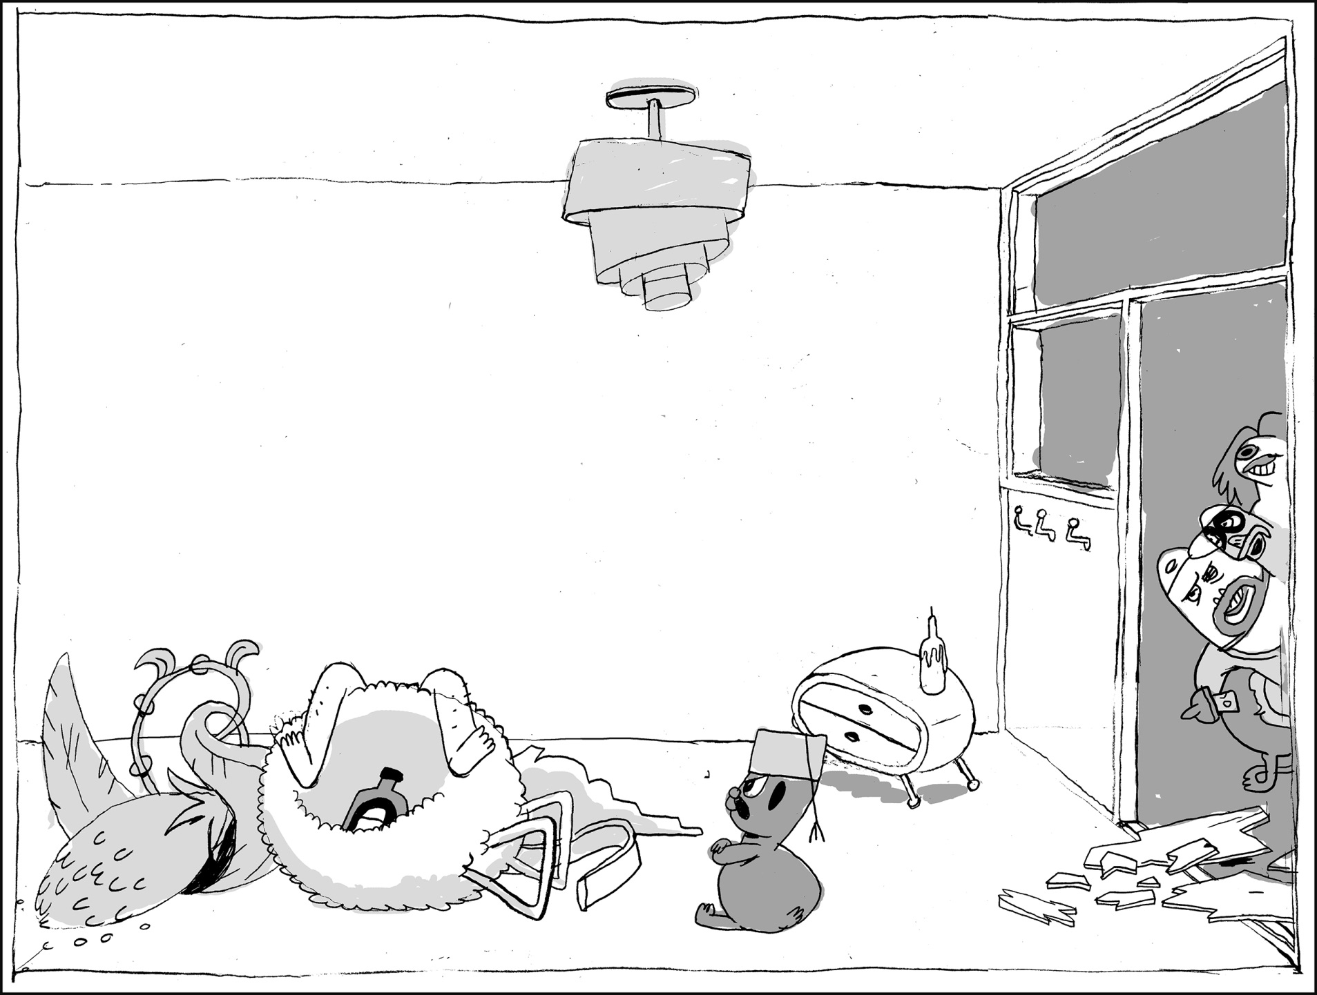
♪MOOONLIGHT ON THE RIVEEEER ♪
OH GUYS, YOU ROCK. DO YOU KNOW THAT?
HAHA, YOU ROCK TOO MAN.

Slide 30
I GOTTA BE HONEST, I WAS A BIT INTIMIDATED BY YOU AT FIRST. BUT I’M SO GLAD I *HIC* GOT TO KNOW YOU.
GLAD TO HEAR IT, DUDE. BUT WE’RE GOTTA BOUNCE NOW. THANKS AGAIN FOR SAVING OUR VASE.
YEAH YEAH YEAH, NO PROBLEM. SEE YOU!

Slide 31
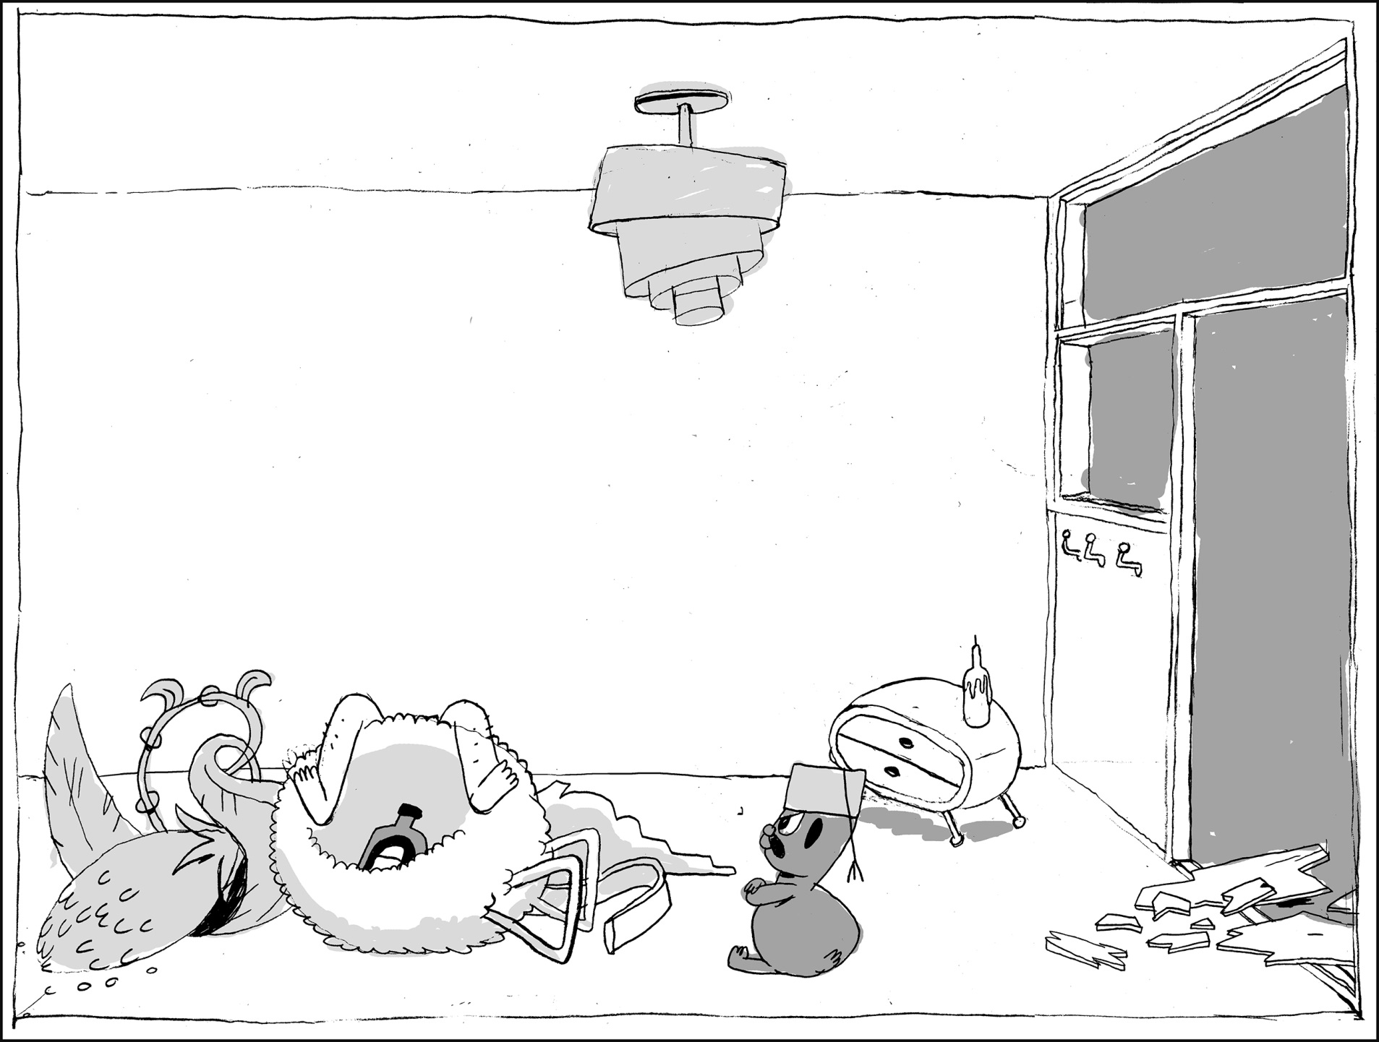
BALTHAZAR. PREPARE TO GET *HIC* YOUR MIND BLOWN.

Slide 32
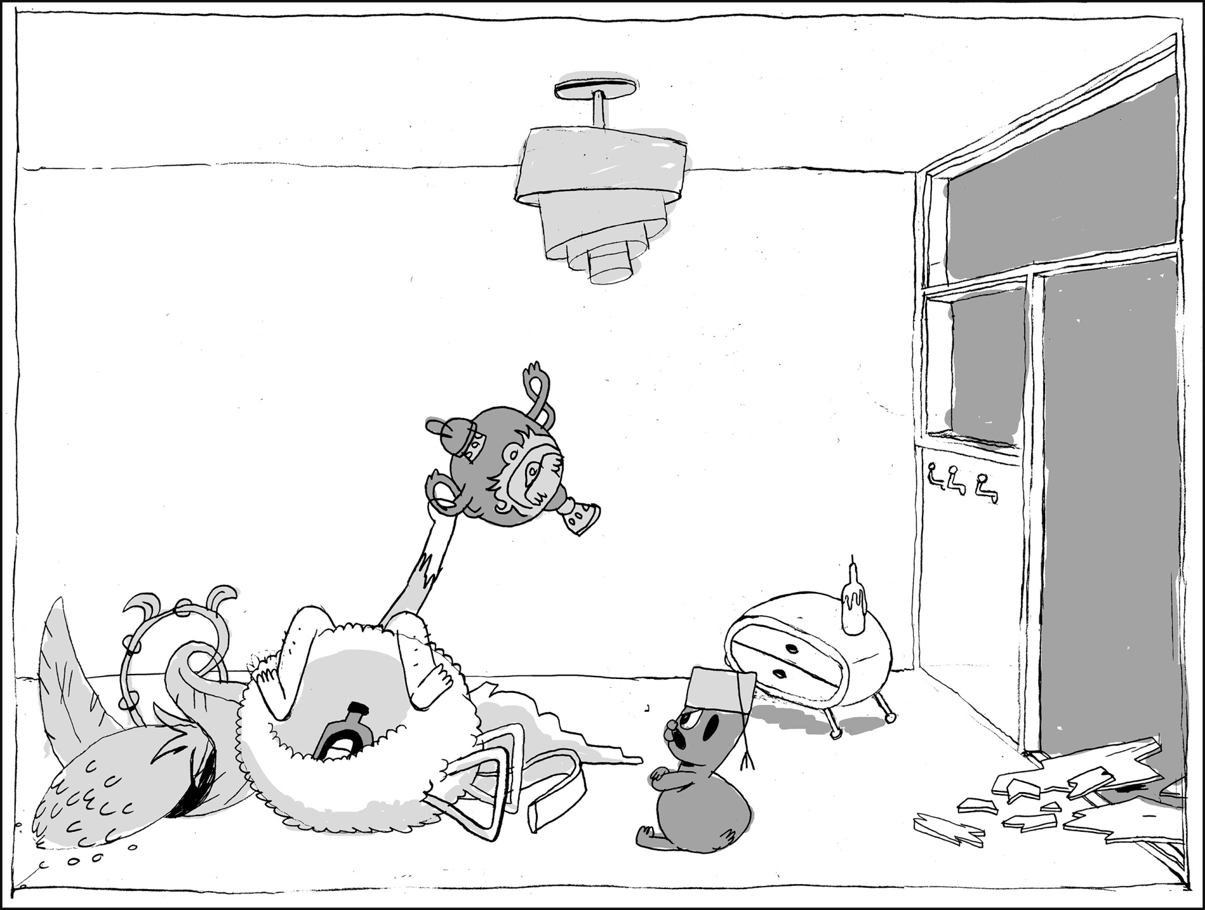
I GAVE THEM A FAKE, BALTHAZAR! I GOT A FAKE VASE MADE YESTERDAY AND THAT’S THE ONE THEY HAVE!! HAHAHA!

Slide 33
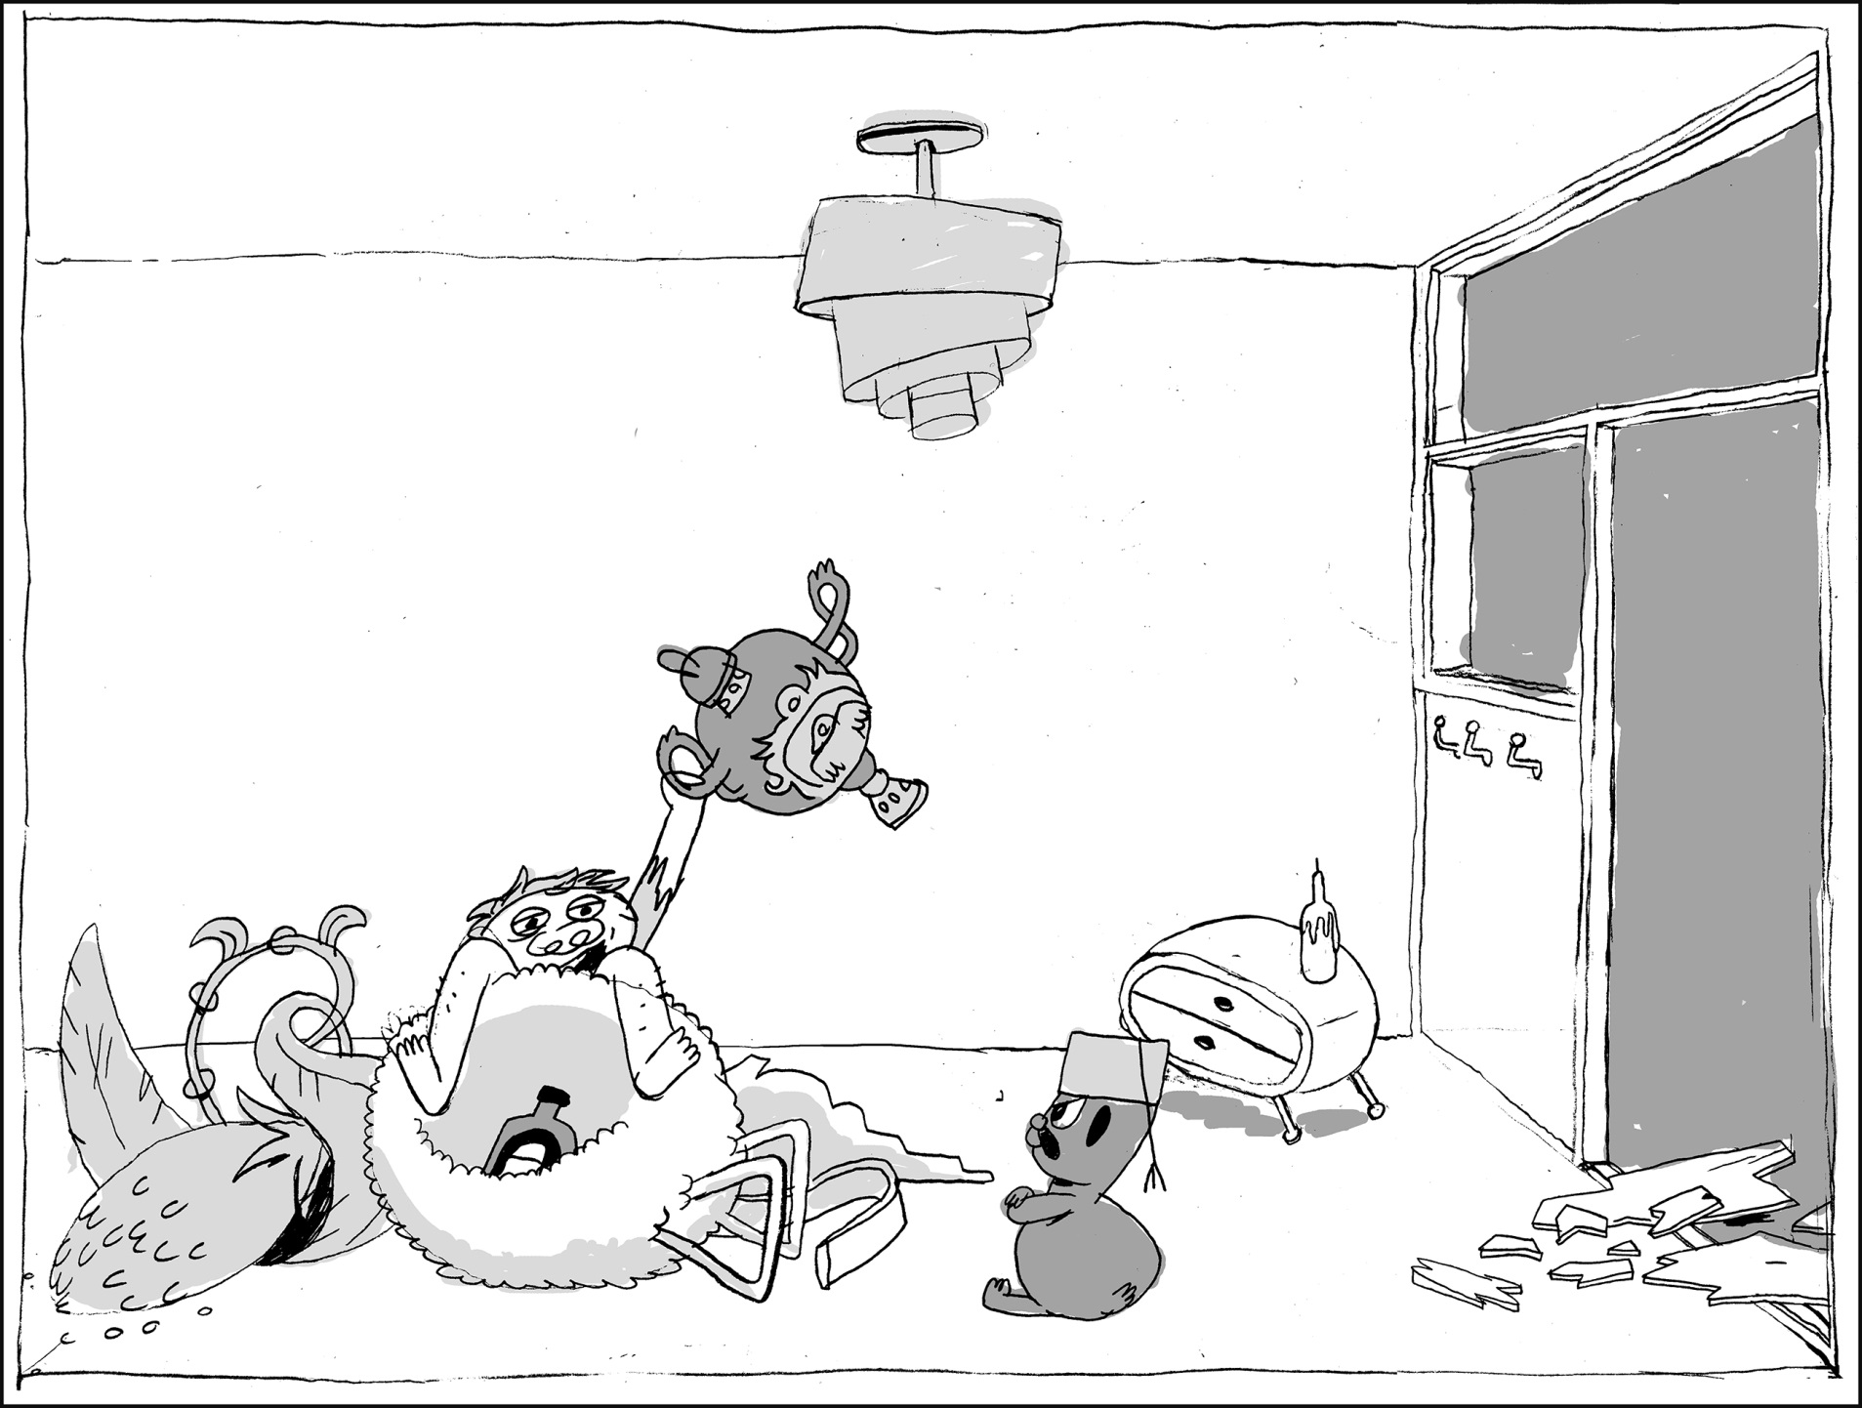
ISN’T THAT CLEVER? AM I NOT ONE HELL OF A MASTERMIND, BALTHAZAR?
WHY ARE YOU LOOKING AT ME THAT WAY??

